Slide 1
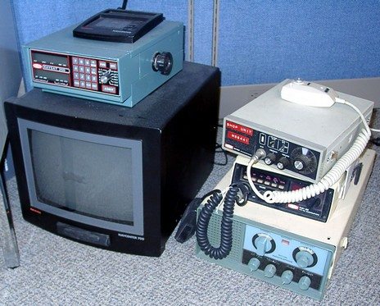
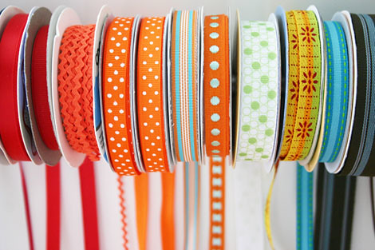
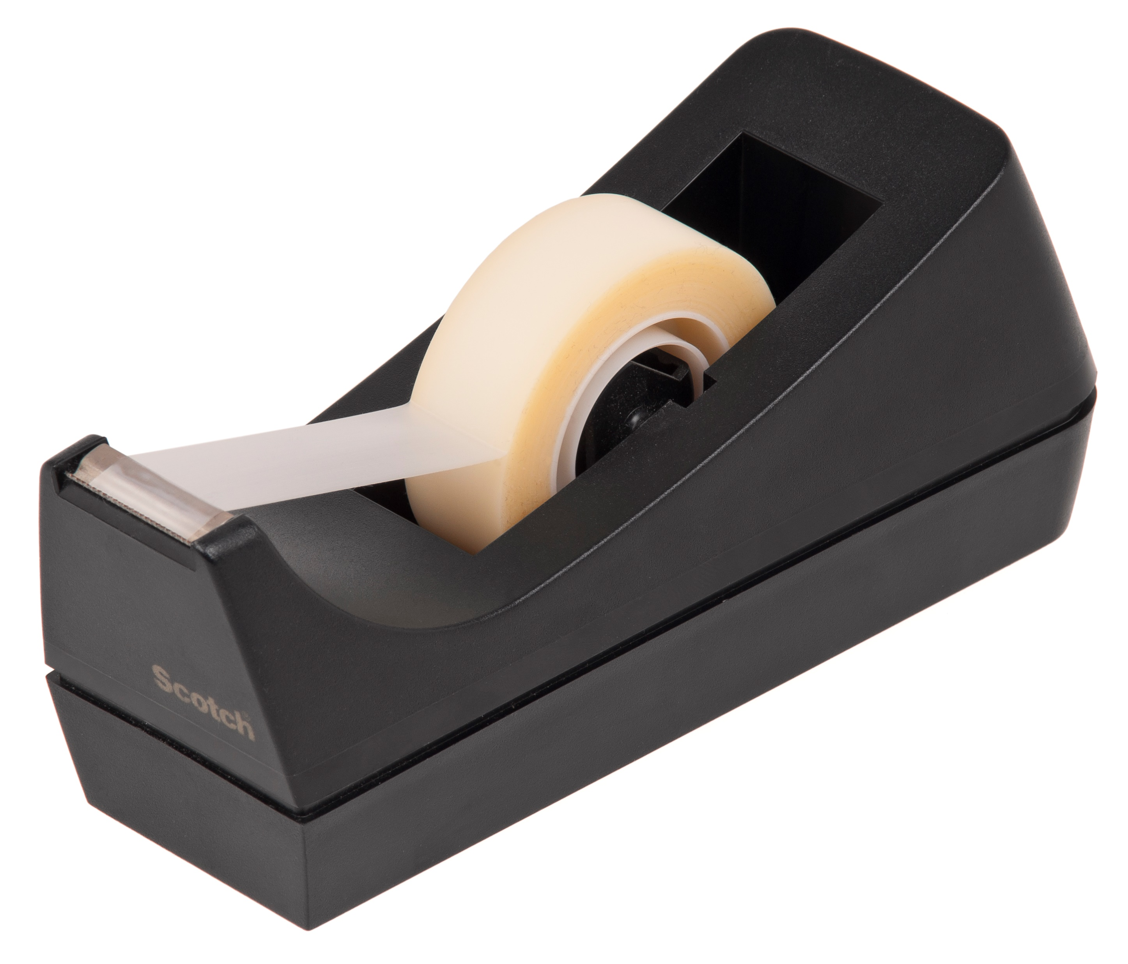
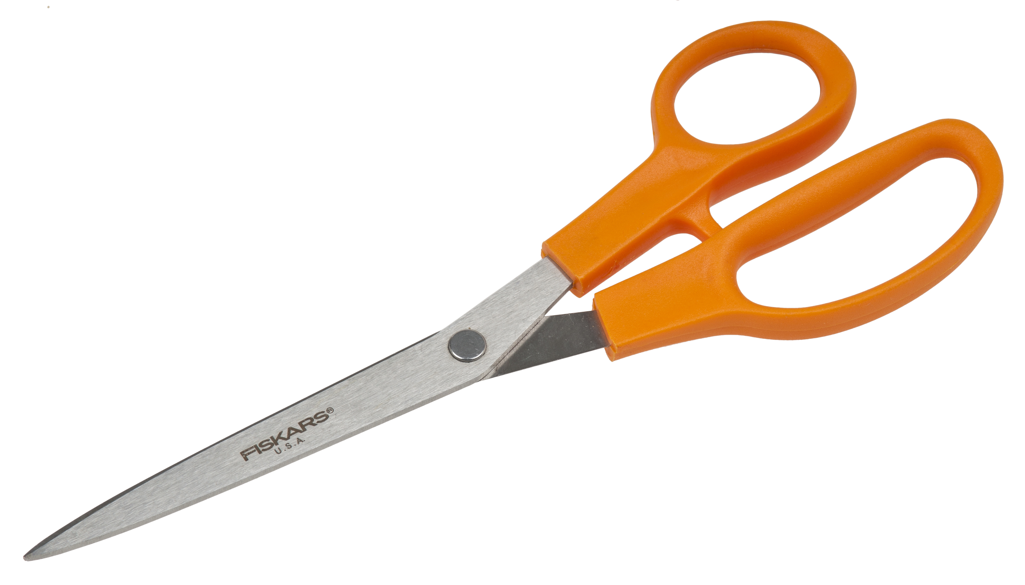
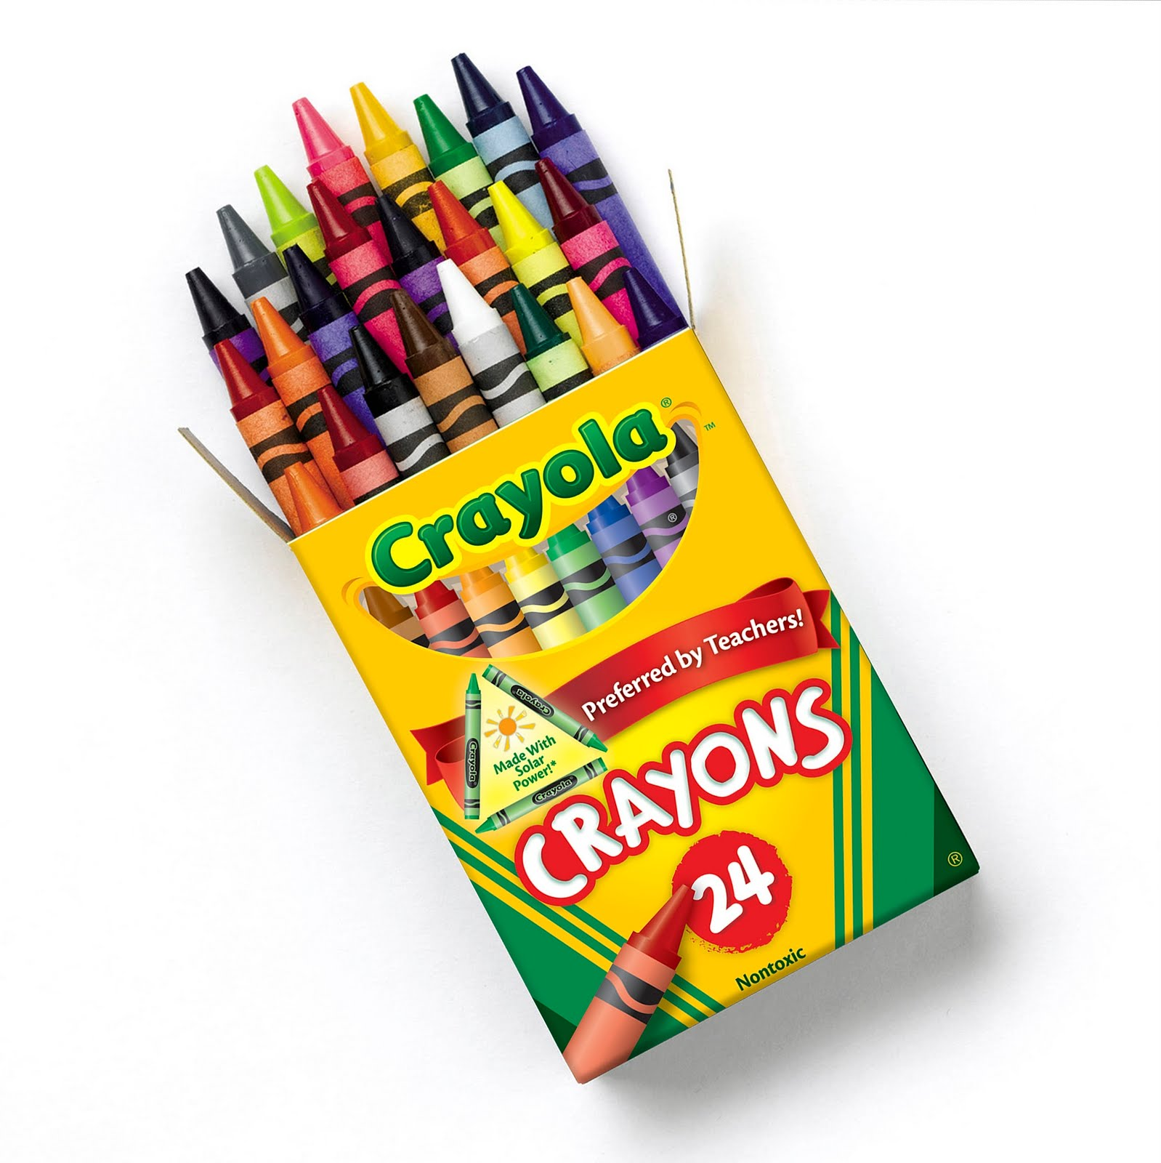
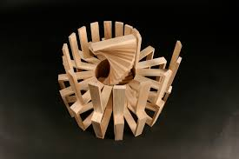
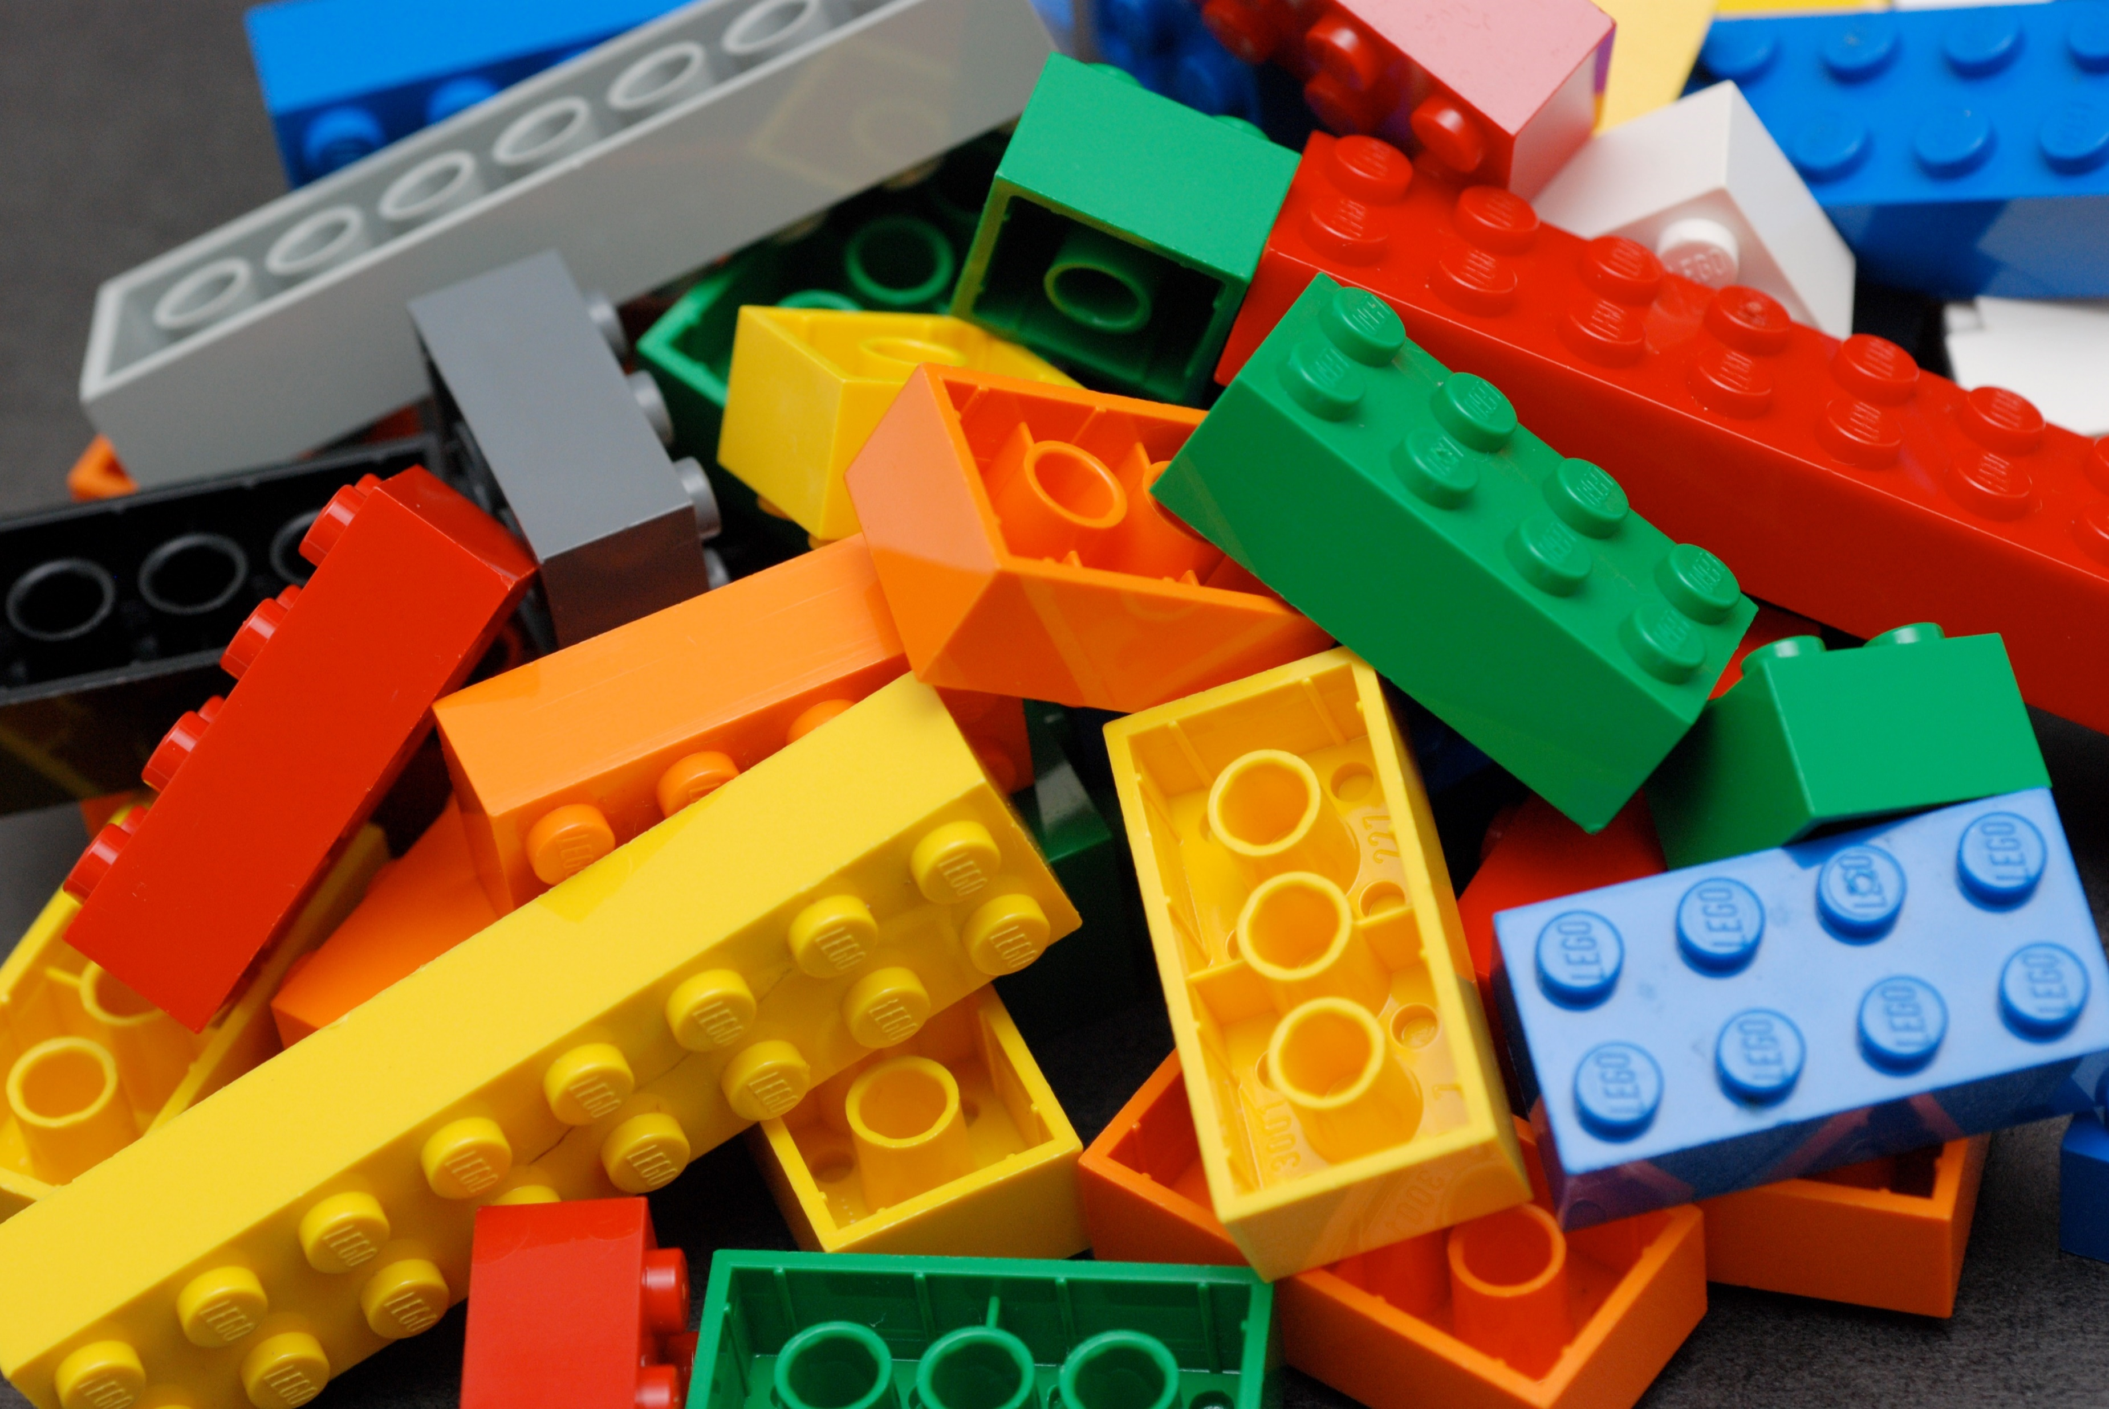
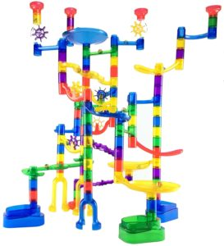
Electronics
Ribbon
Tape
Scissors
Crayons
Keva Planks
LEGO
Marble Run

Slide 2
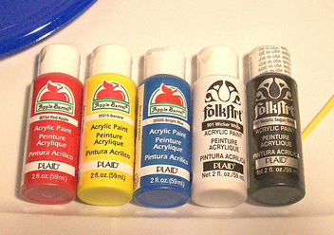
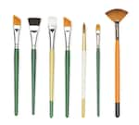
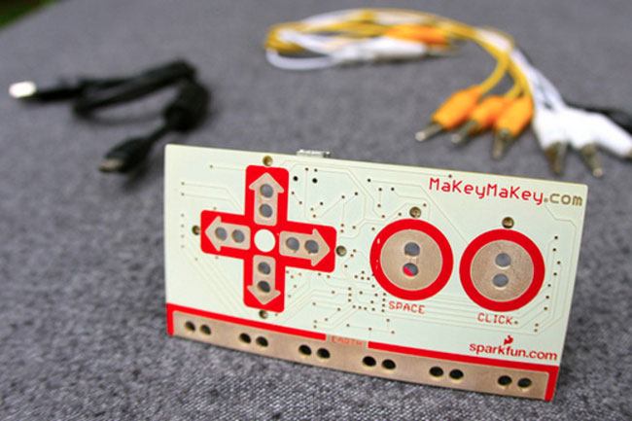
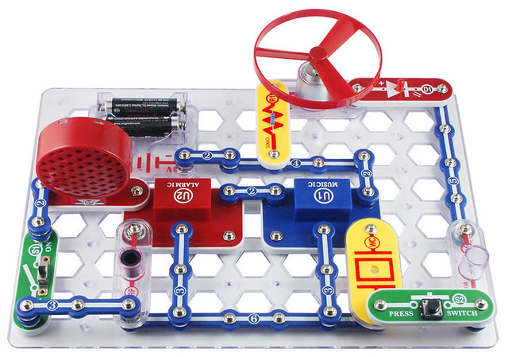
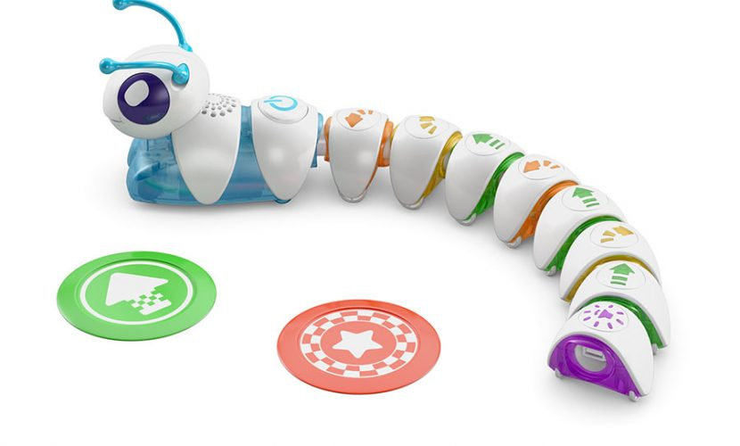
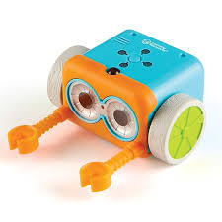
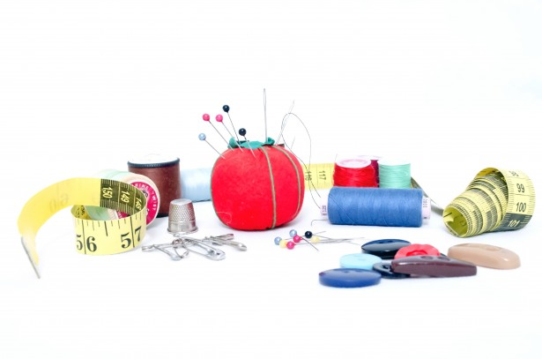
Paint
Paintbrushes
Makey Makeys
Spheros
Snap Circuits
Code-a-Pillars
Botley
Sewing

Slide 3
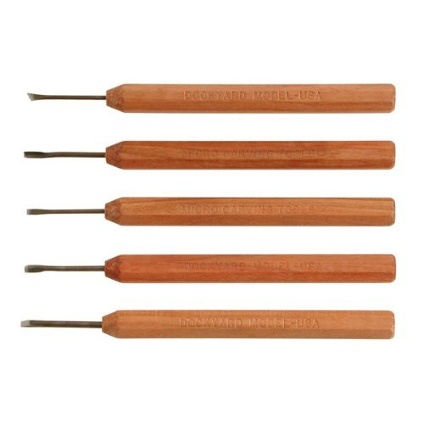
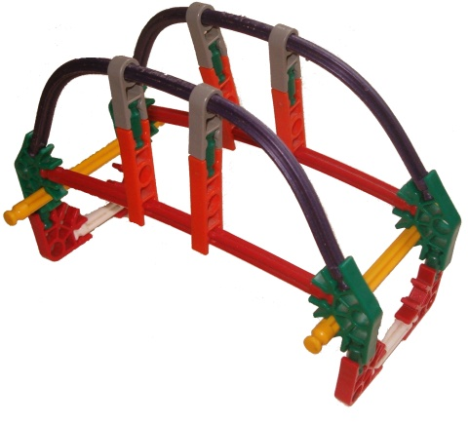
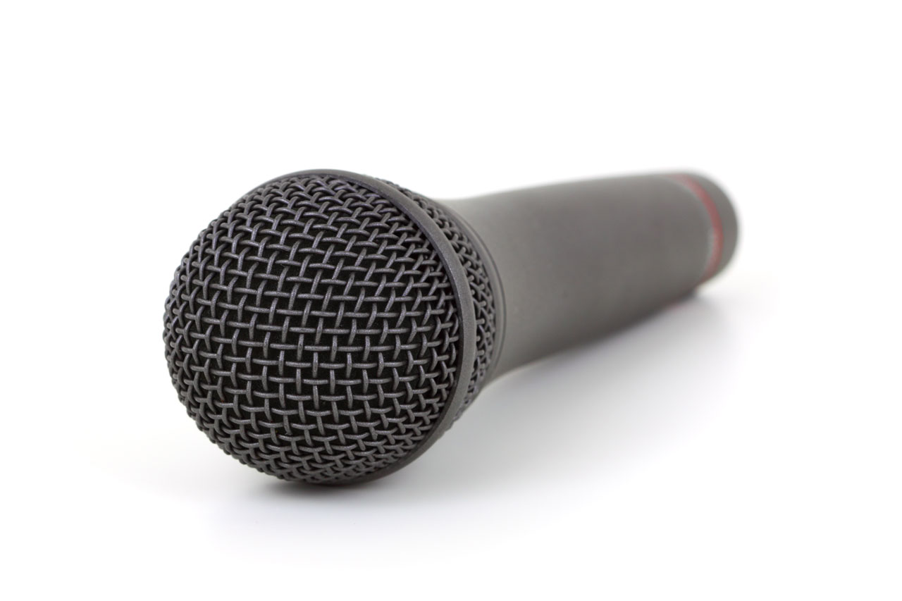
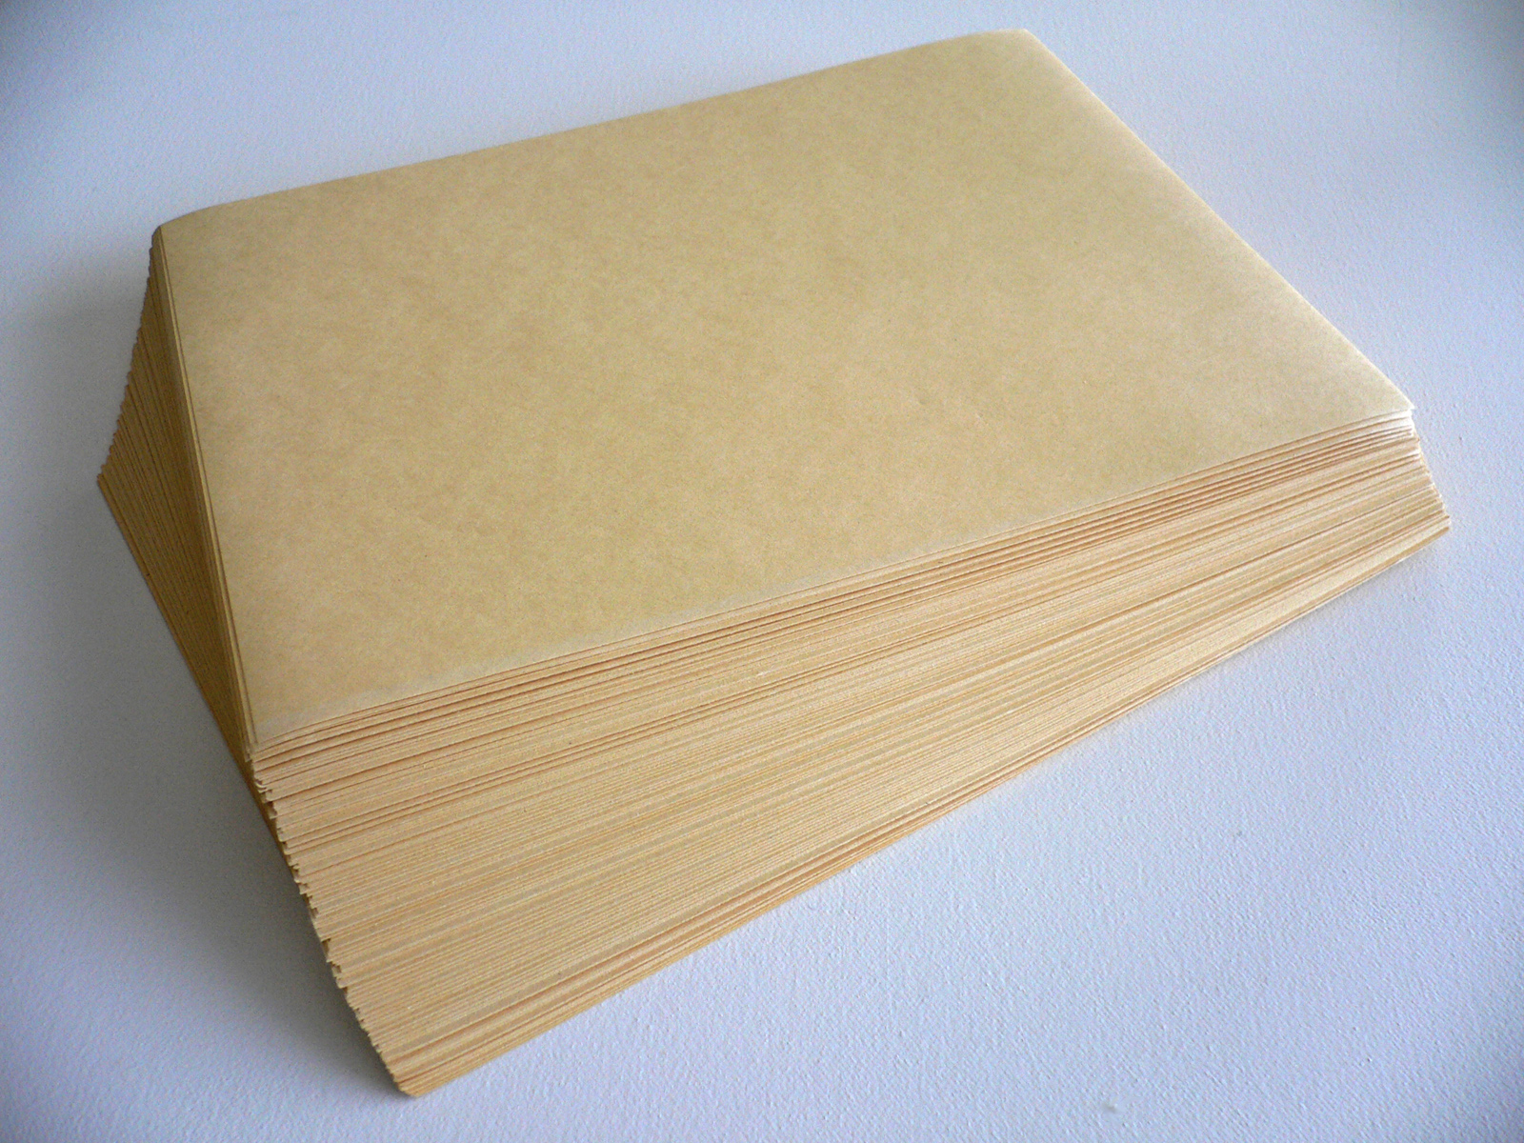
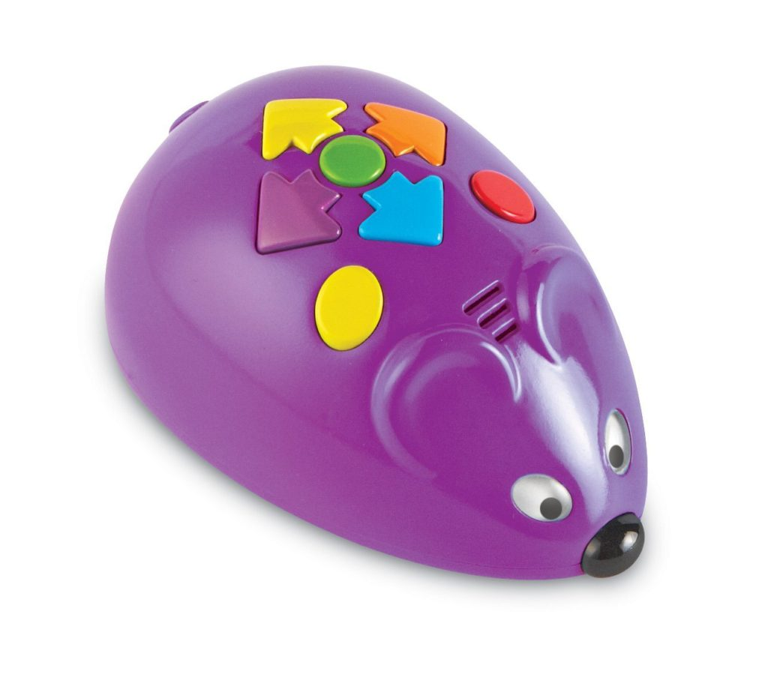
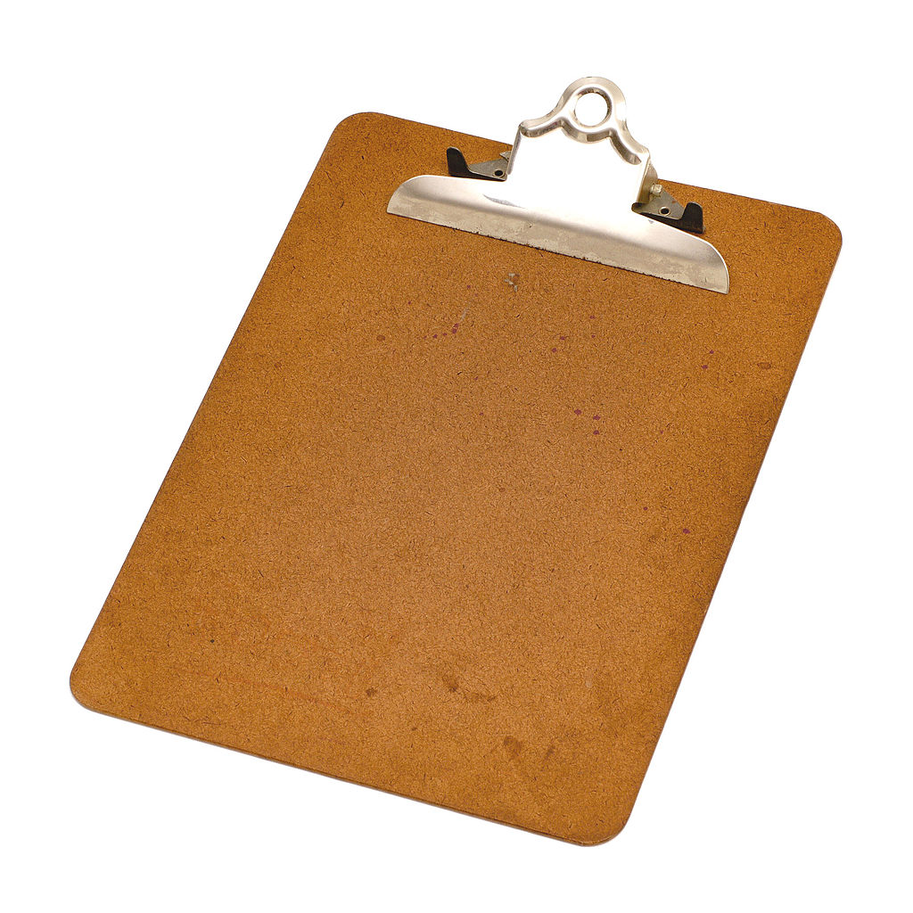
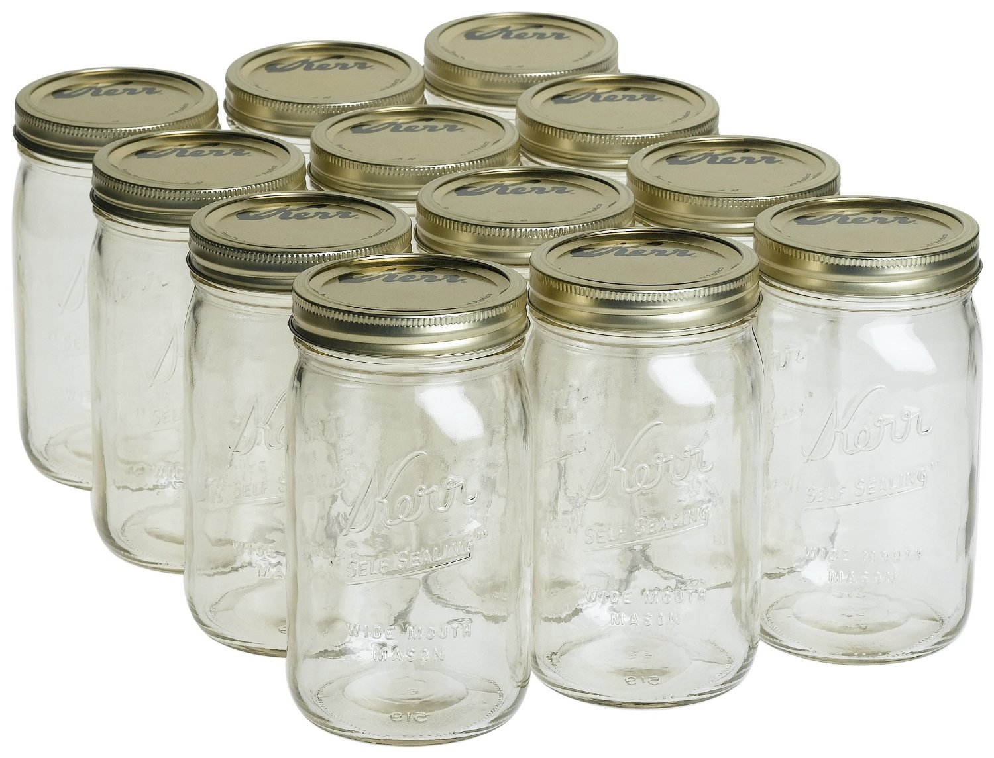
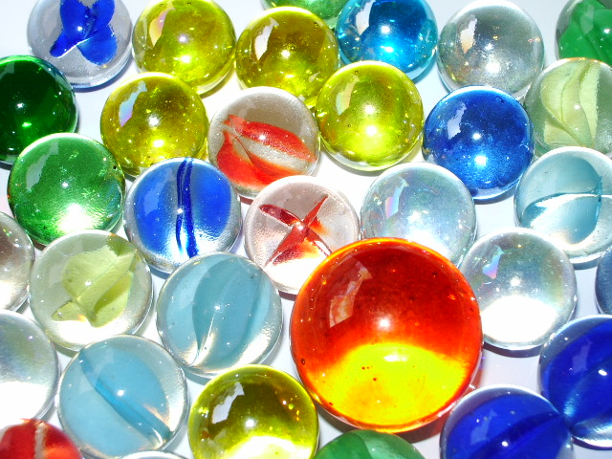
Clay Tools
K’Nex
Microphones
Paper
Code and Go Mouse
Clipboards
Jars
Marbles

Slide 4
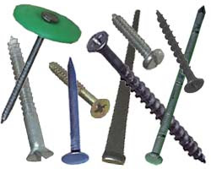
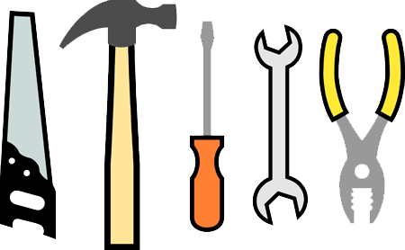
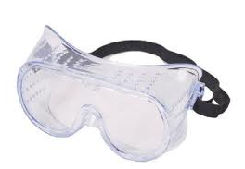
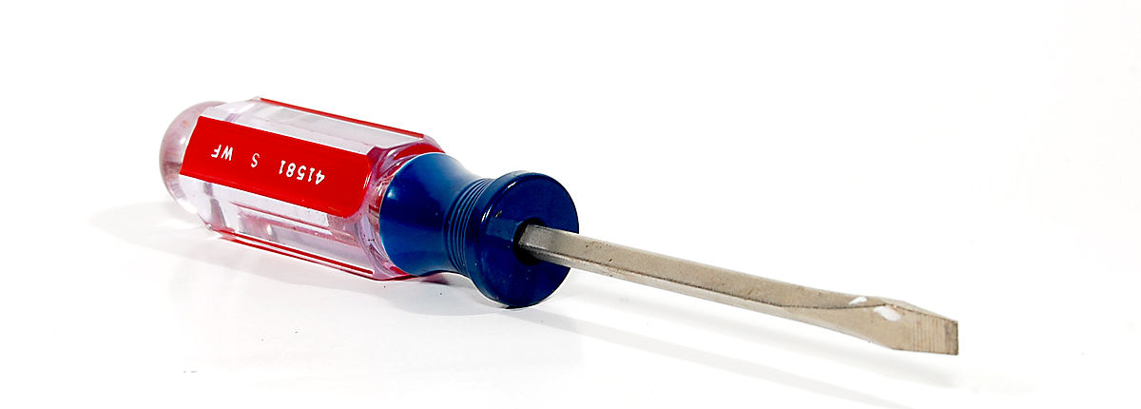
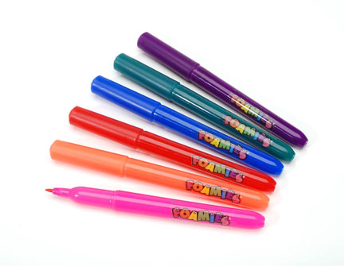
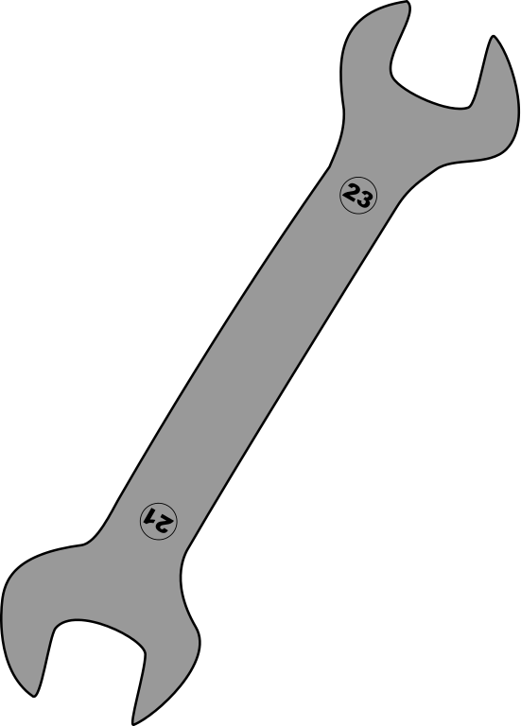
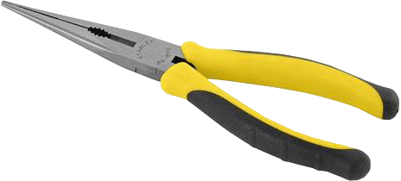
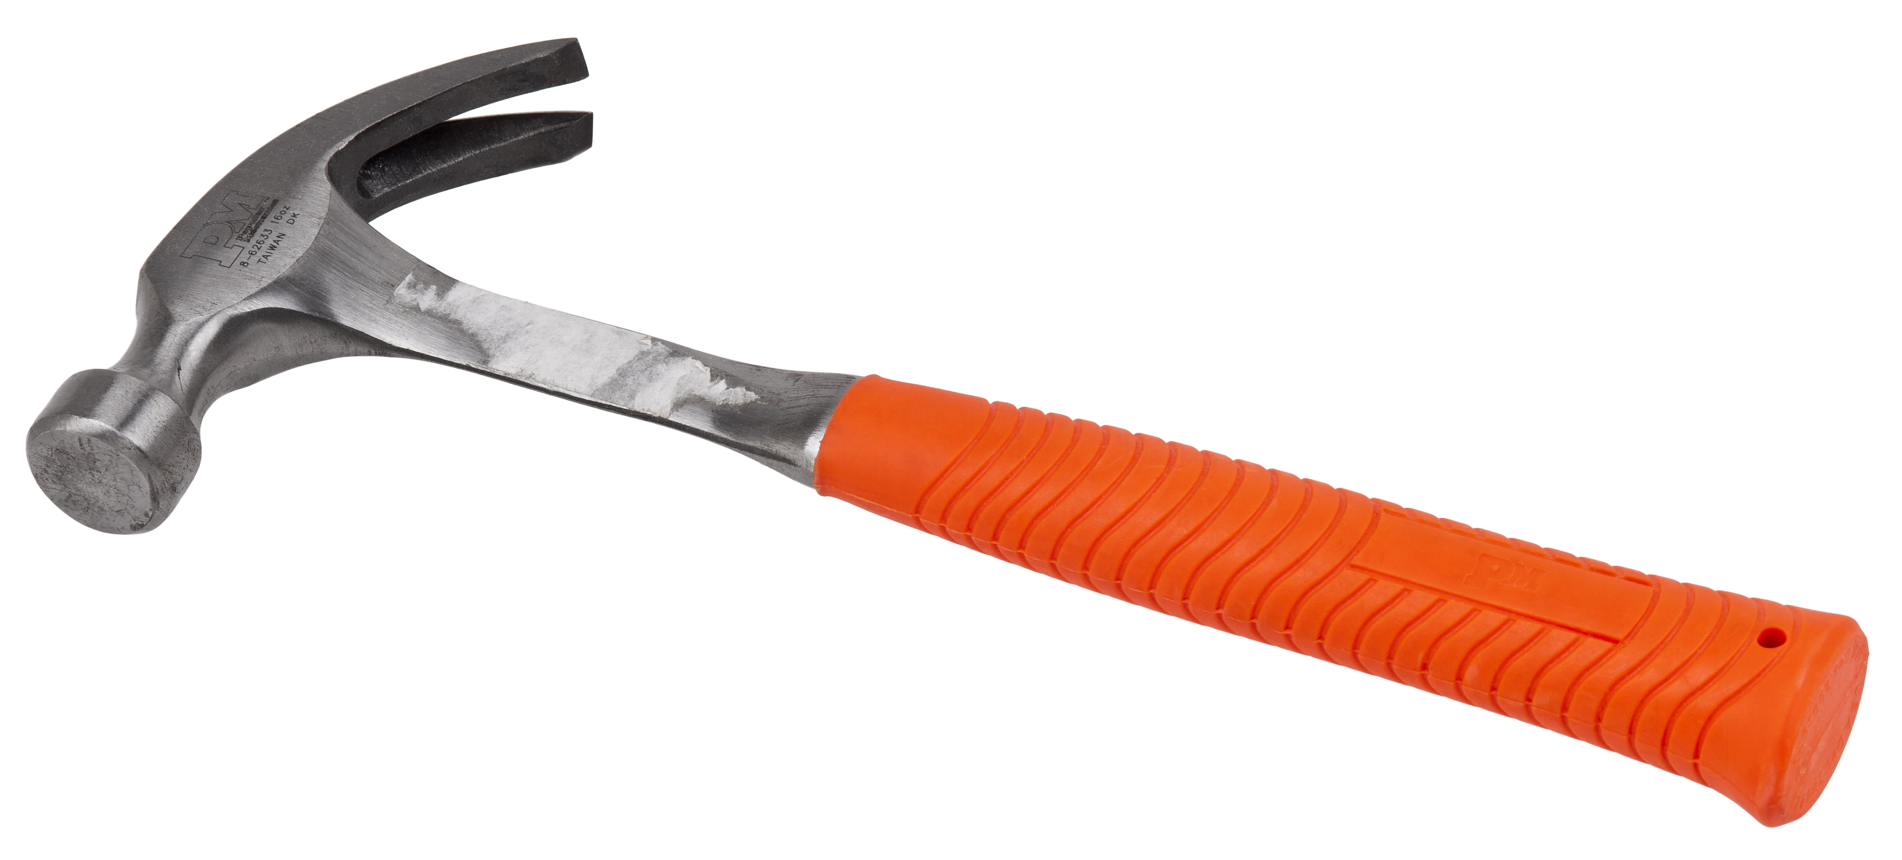
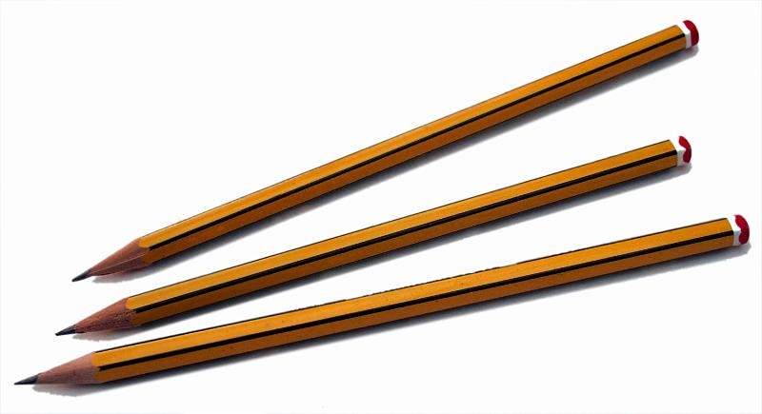
Nails and Screws
Tools
Safety Goggles
Screwdrivers
Pliers and Wrenches
Markers
Hammers
Pencils

Slide 5
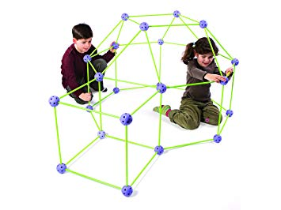
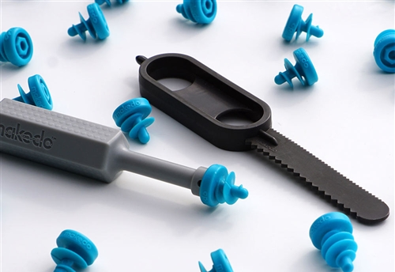
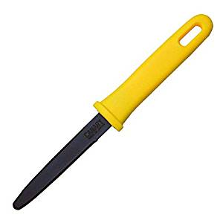
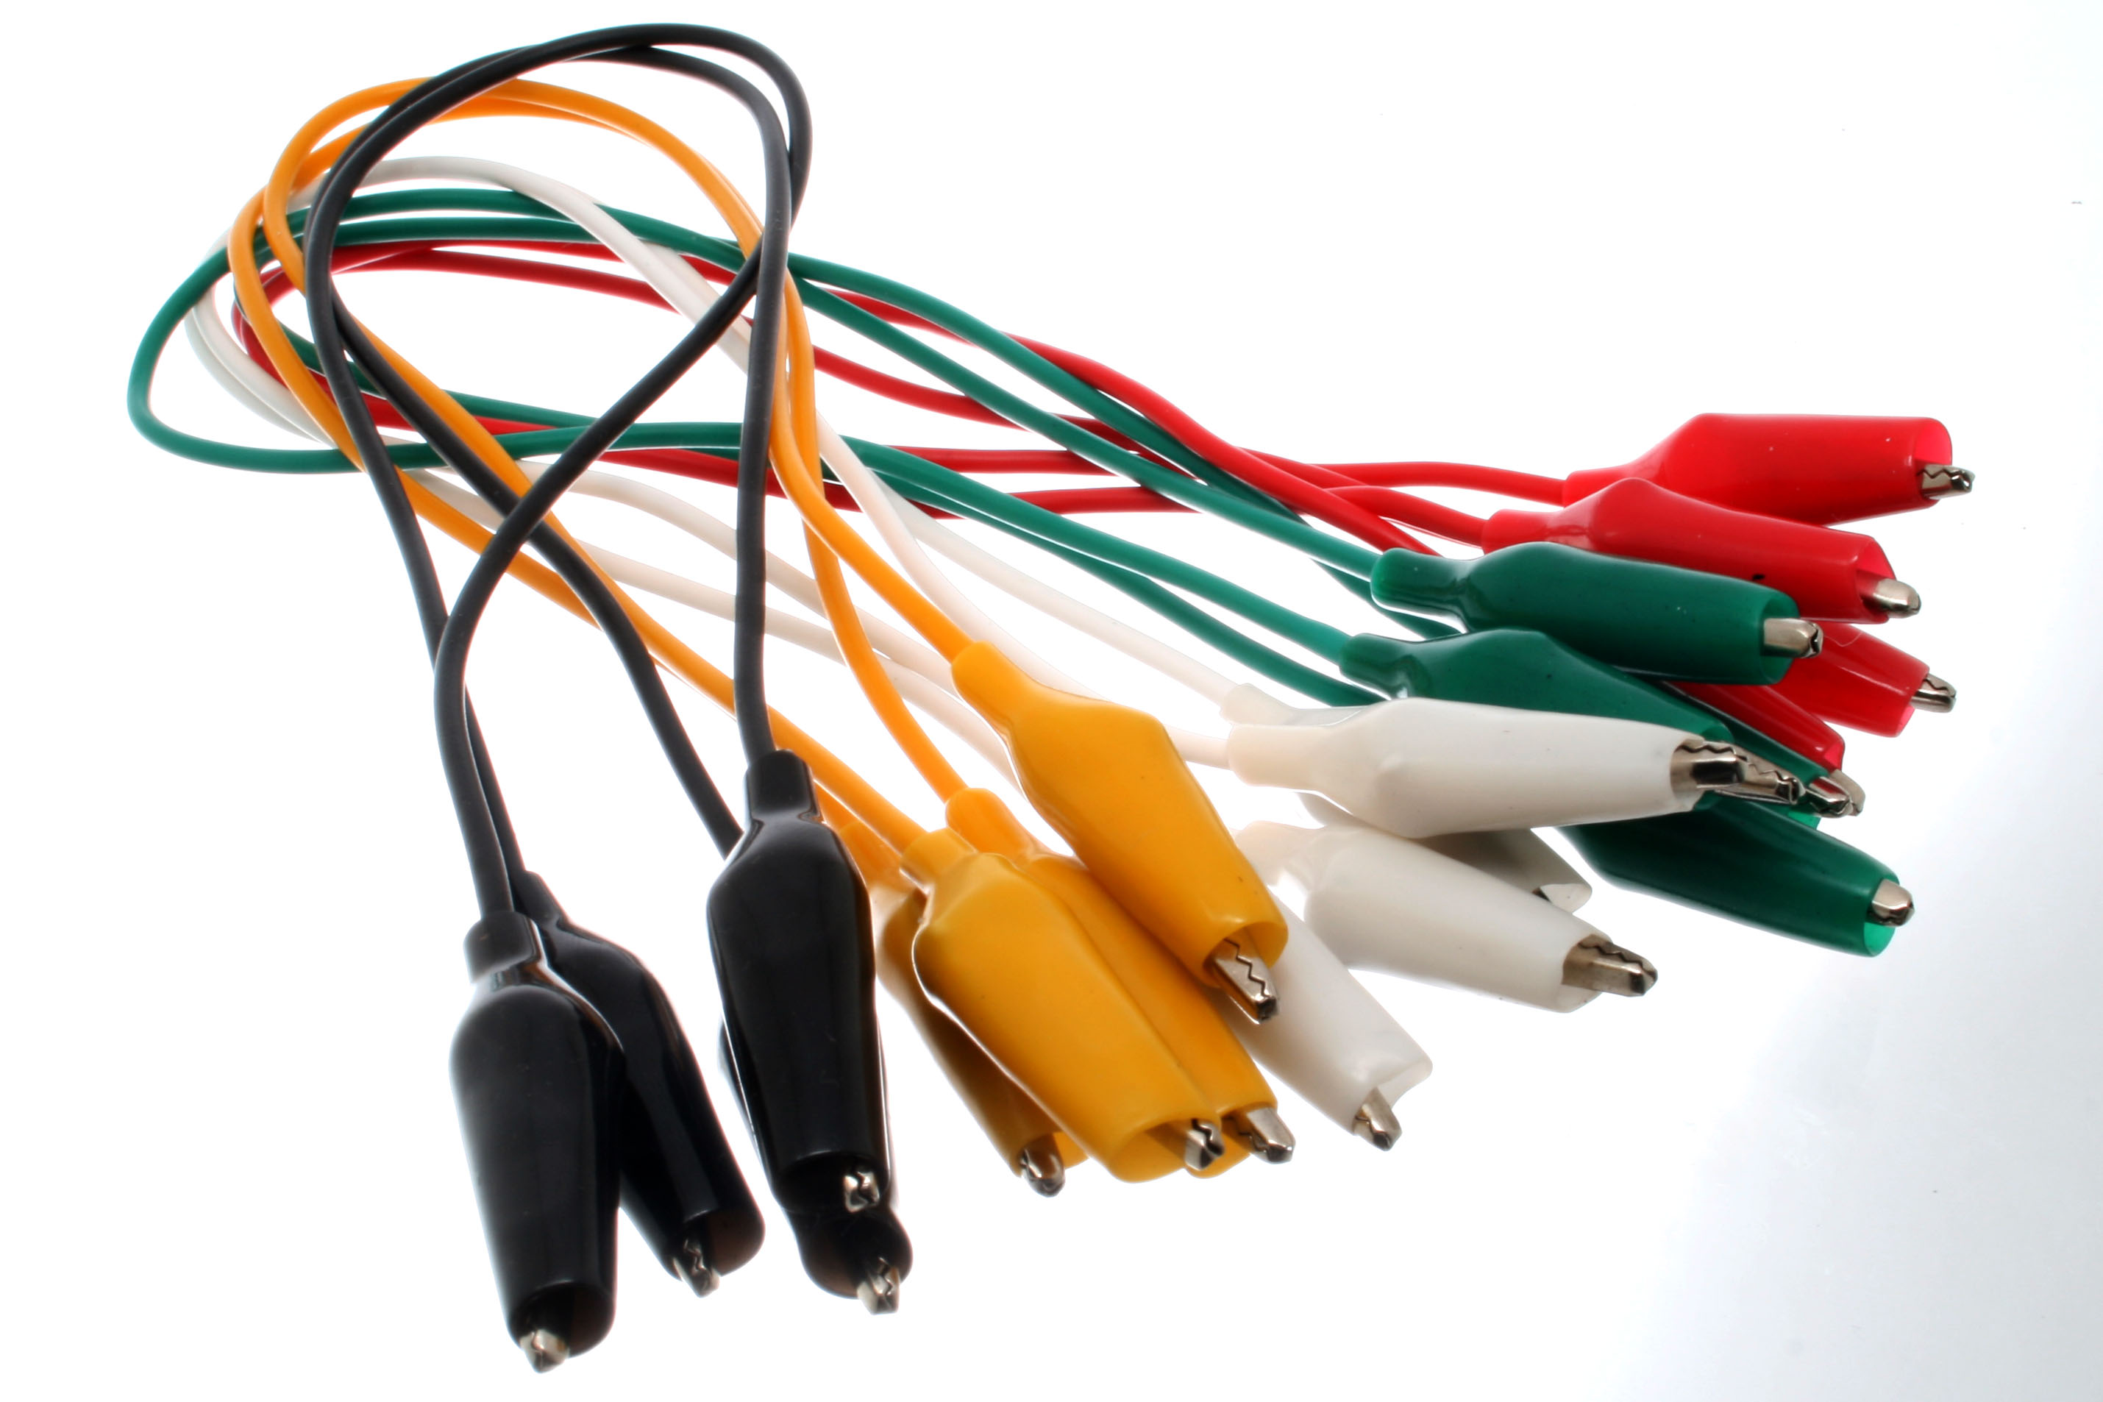
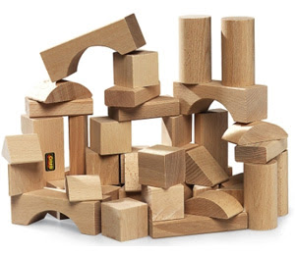
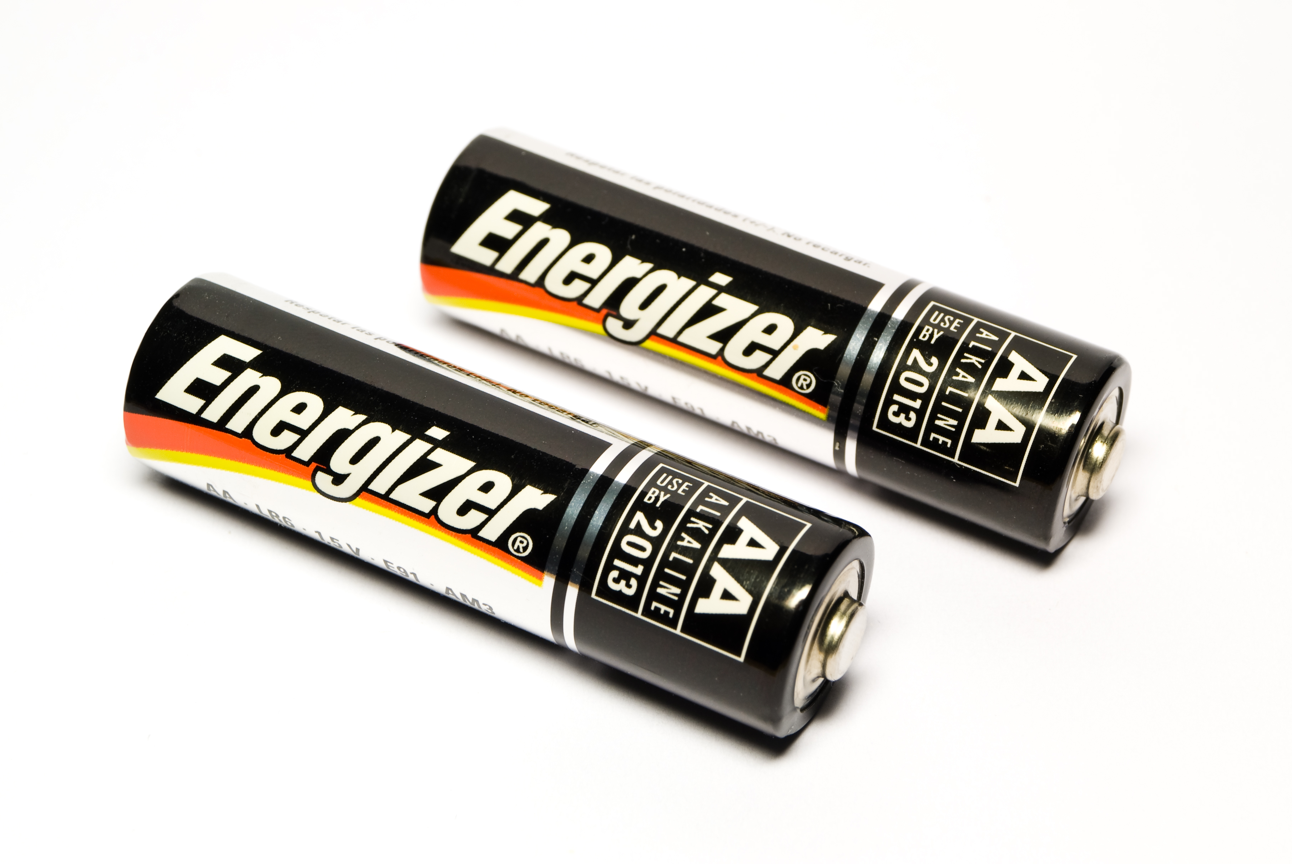
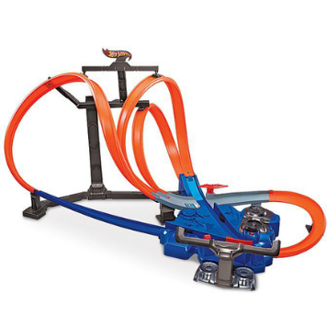
Crazy Forts
Make Do Kit
Cardboard Cutters
Alligator Clips
Blocks
Batteries
LEGO
Hot Wheels Tracks

Slide 6
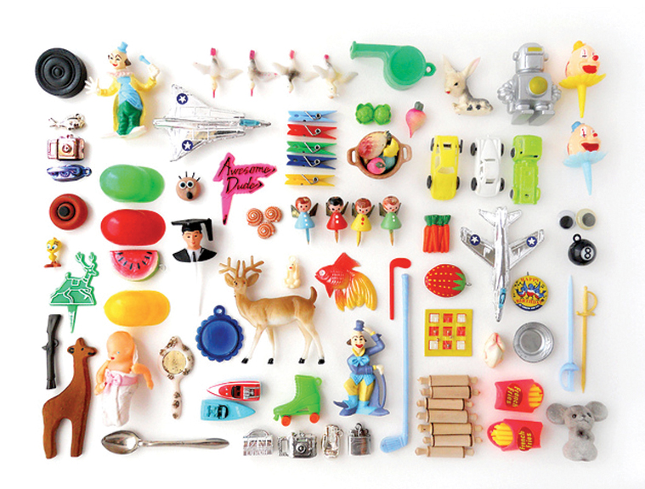
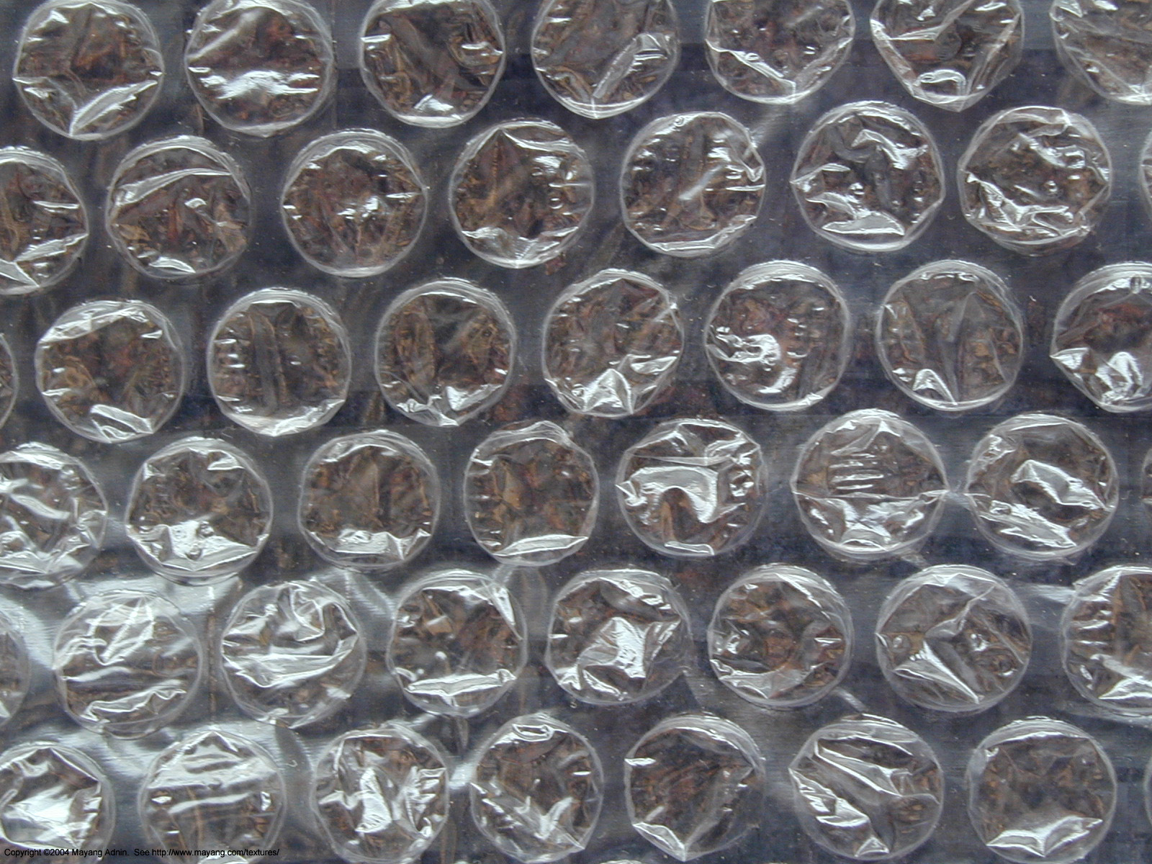
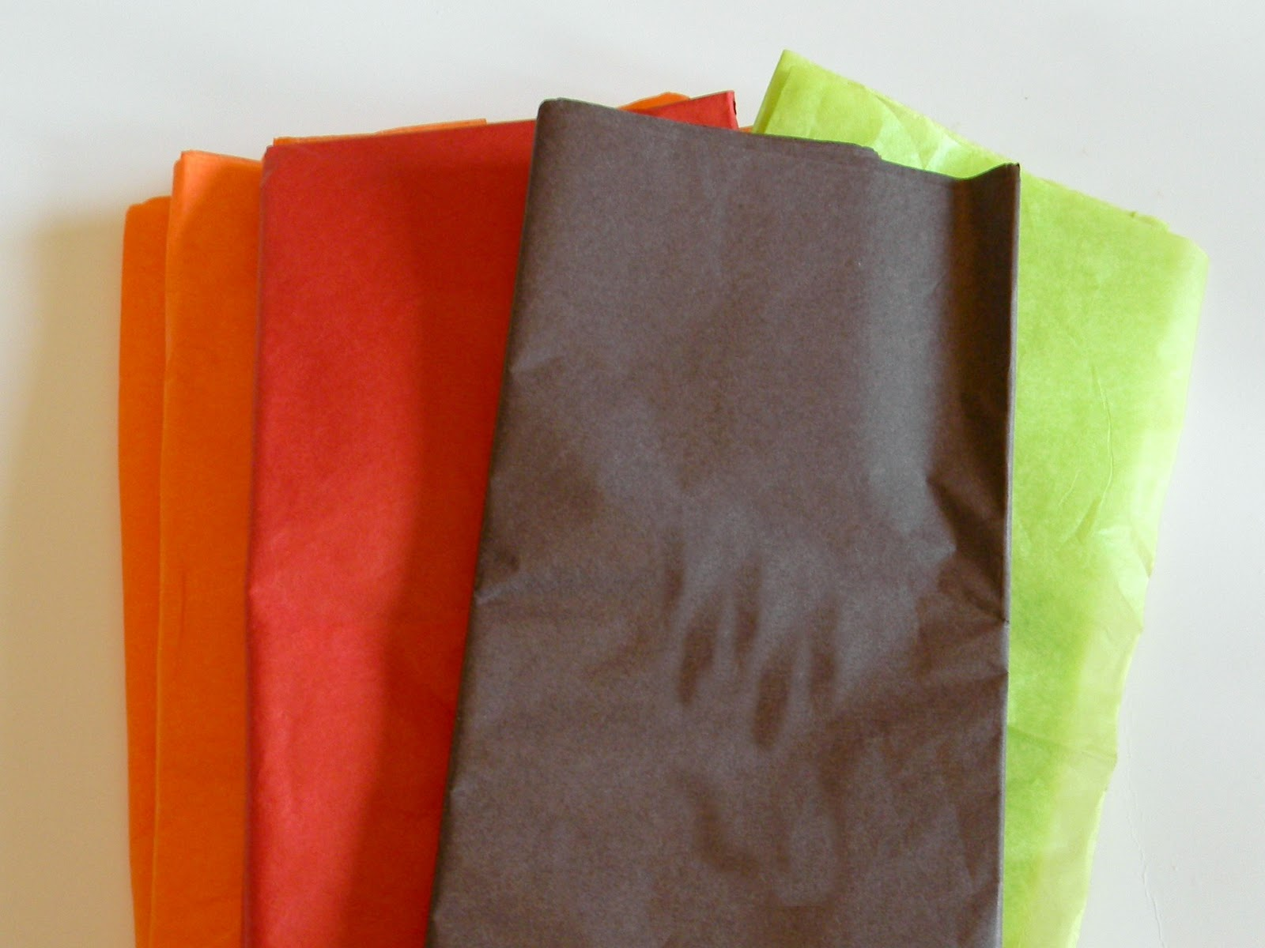
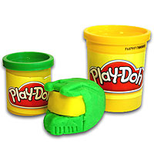
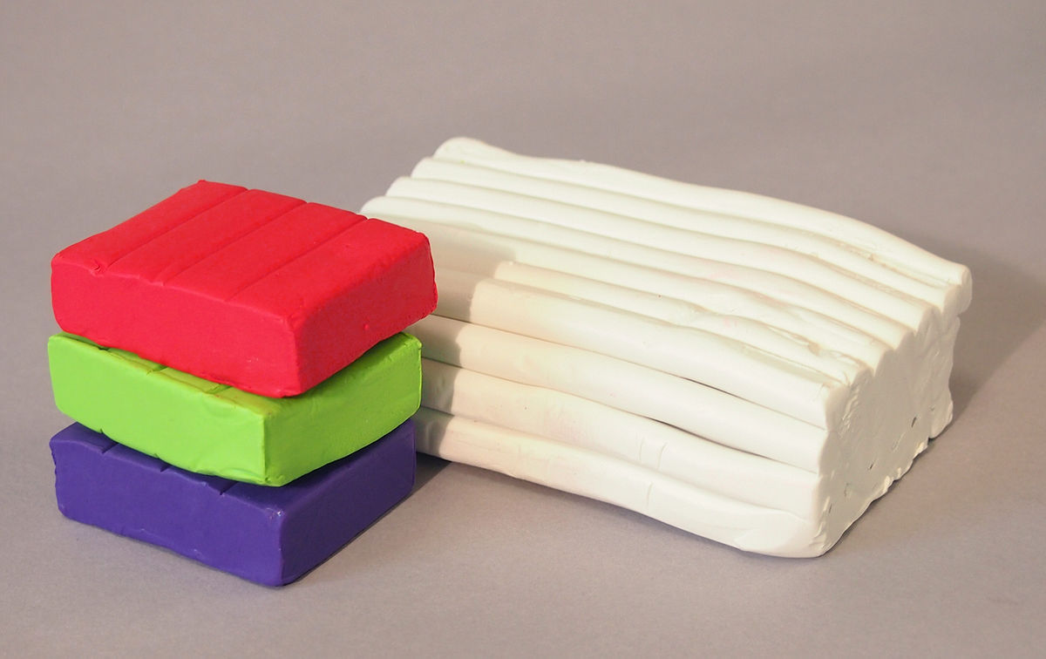
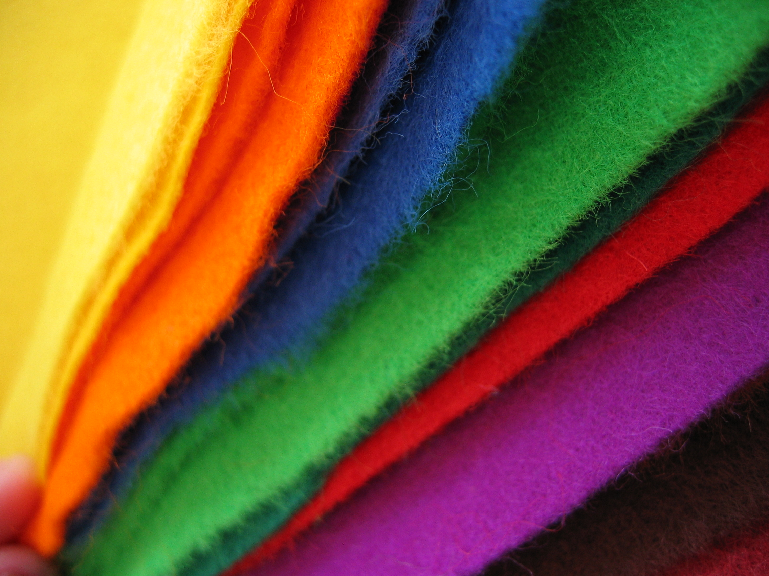
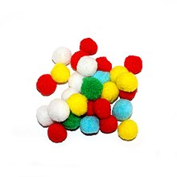
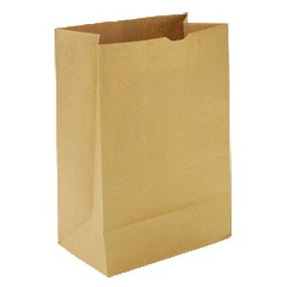
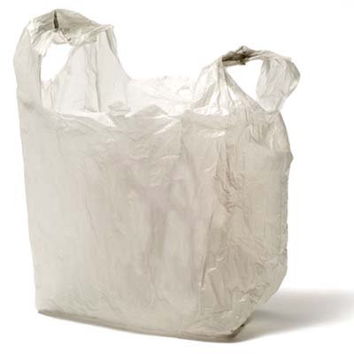
Random Bits
Bubble Wrap
Tissue Paper
Play Doh
Clay
Felt and Fabric
Pompoms
Bags

Slide 7
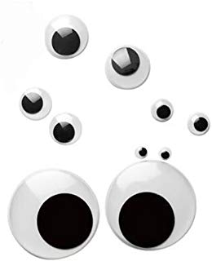
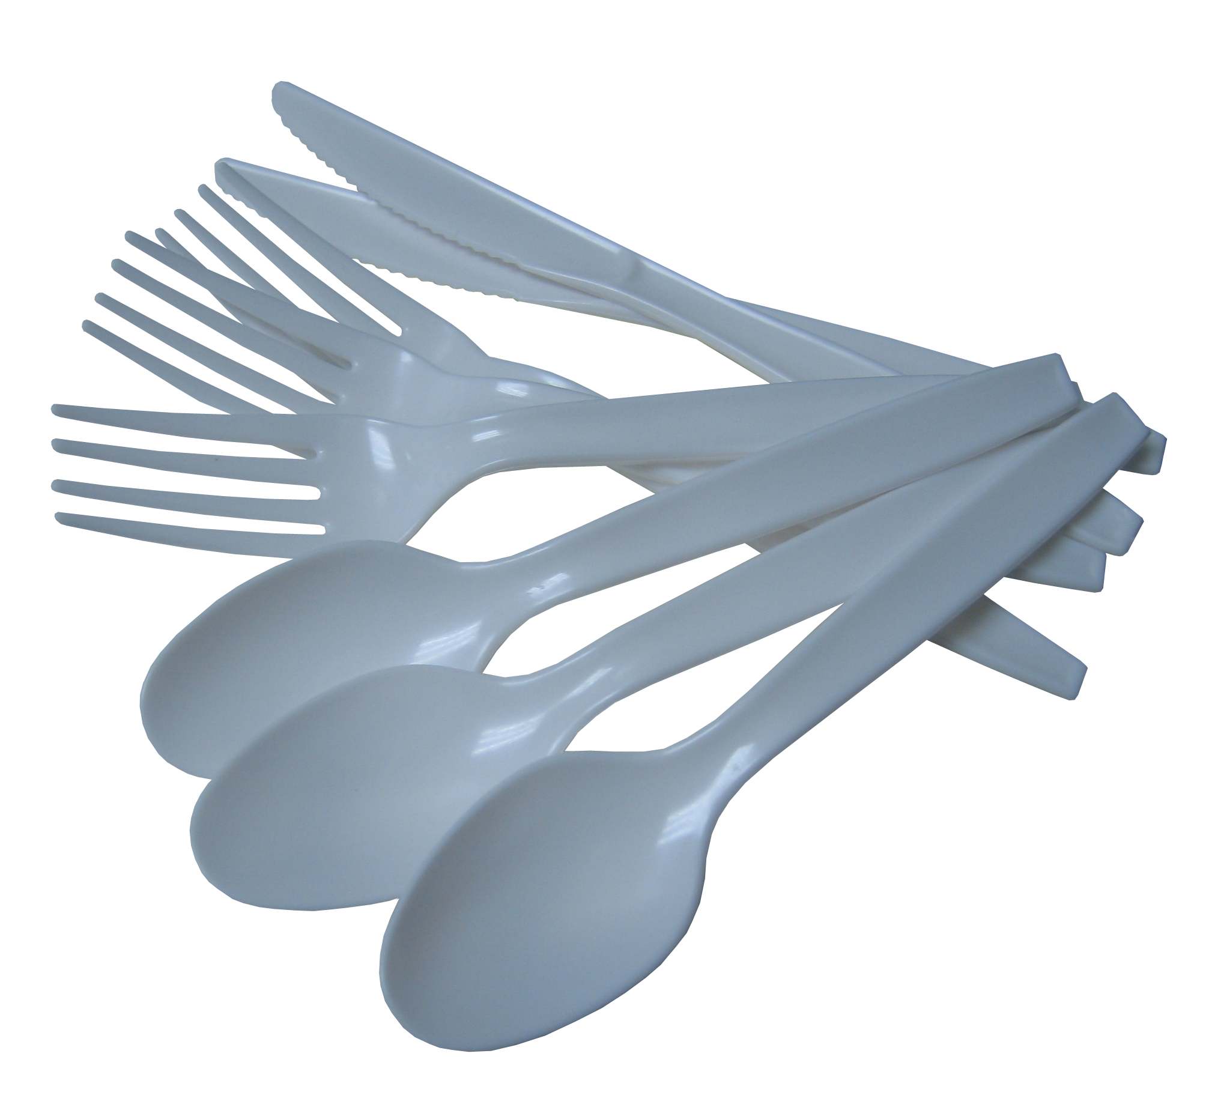
Google Eyes
Cutlery
Plates and Cups
Buttons
Glue Guns and Sticks
Beads
Wheels
Plastic Bottles

Slide 8
Fasteners
Newspaper
Aluminum Foil and
Plastic Wrap
Yarn and String
Egg Cartons
Styrofoam
Elastics
Feathers

Slide 9
Cotton Balls
Wooden skewers
Clothespins
Balloons
Pipe Cleaners
Bottle Caps
Straws
Filters

Slide 10
Pencil Crayons
Cotton Swabs
Zip Ties
Bloxels
Magnets
Popsicle Sticks
Gems
Gears

Slide 11
Microbits
Duplo
Copper Tape
Dixie Cups
Rulers
Glue
VR Goggles
3D Doodler Pens

Slide 12
Binding Machine
Battery Packs
Cardboard
Drill
Saw
Paper Tubes
Drone
LEGO EV3

Slide 13
Measuring Tapes
Masking Tape
Duct Tape
Packing Tape
Levels
Wire Cutters

