Slide 1
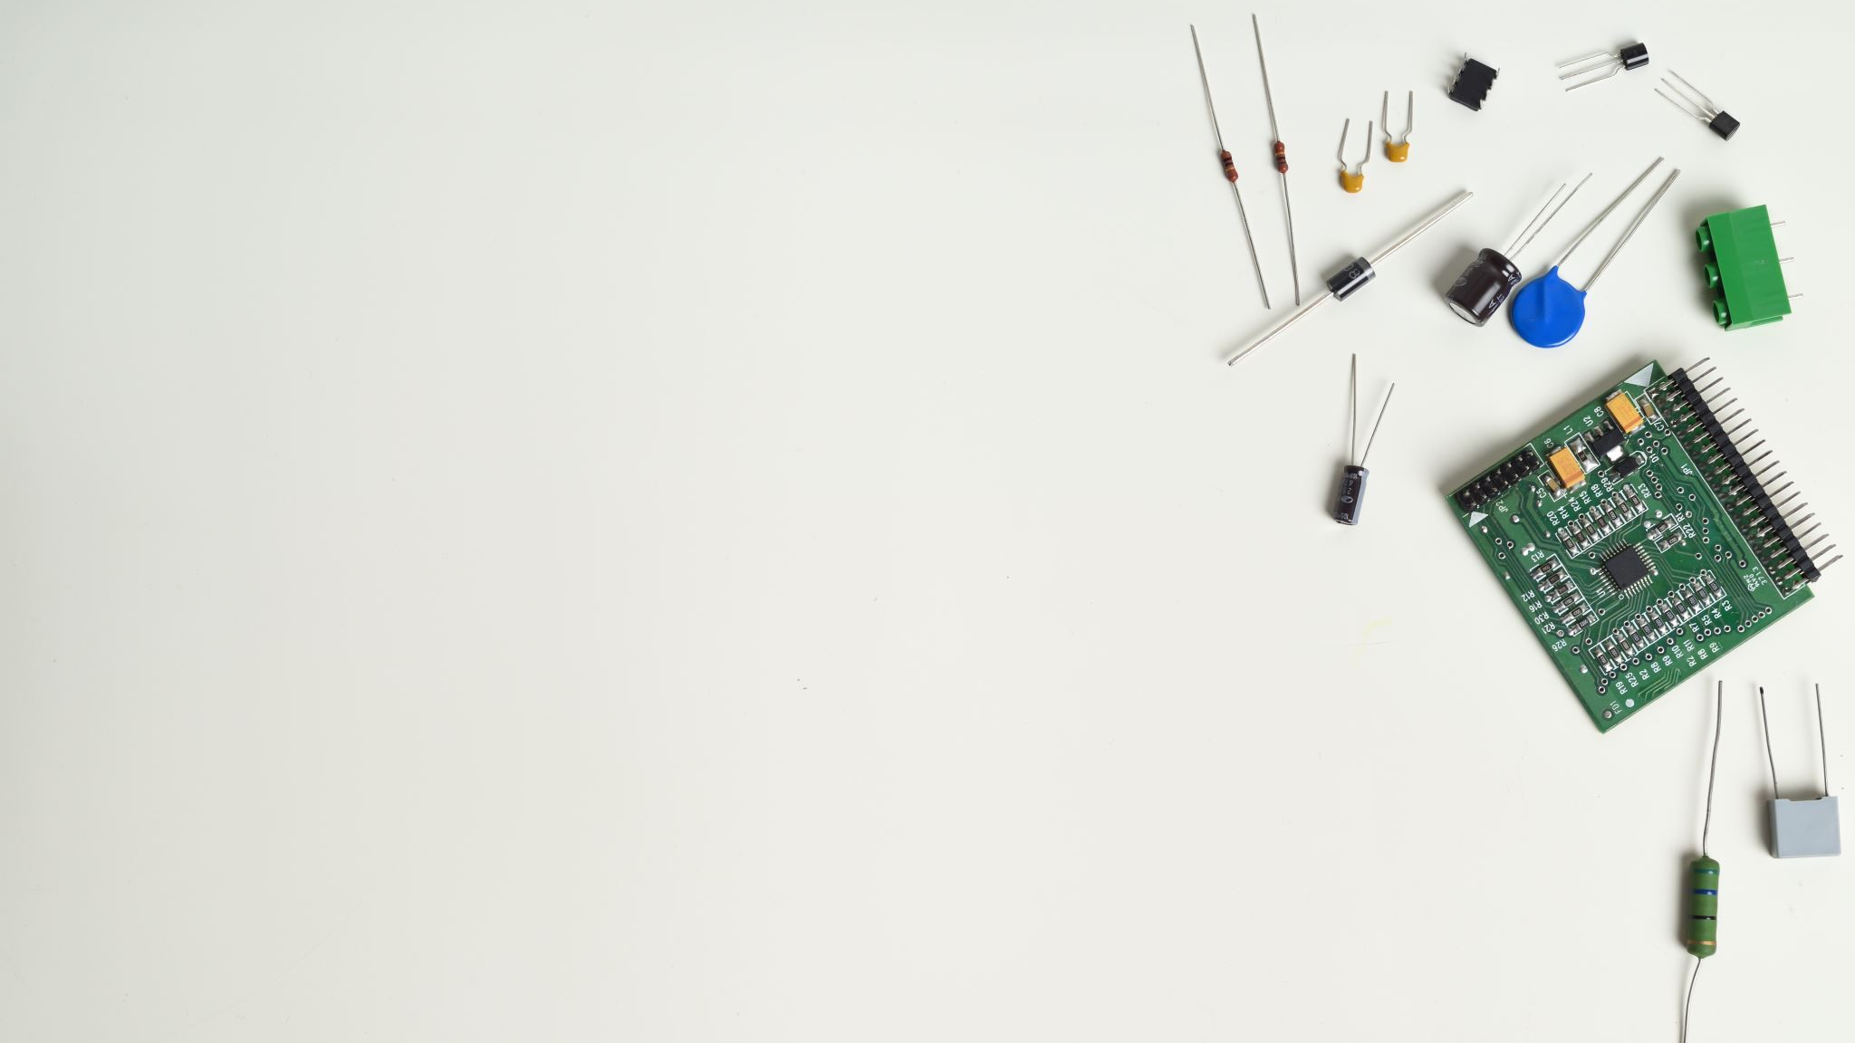
MakerSpace
The Kickstart PL to making Great MAkerspaces in your school

Slide 2
Design Thinking
What is happening in this picture?
What do you think of this design?
Would you change anything?
Would this be useful in your house?
Why did they come up with this product?
What material did they use?
Is there anything you would change?
Notes:
Explorative, Affective, Reflective, Probing, Analytical, Clarifying question. All open ended question.

Slide 3
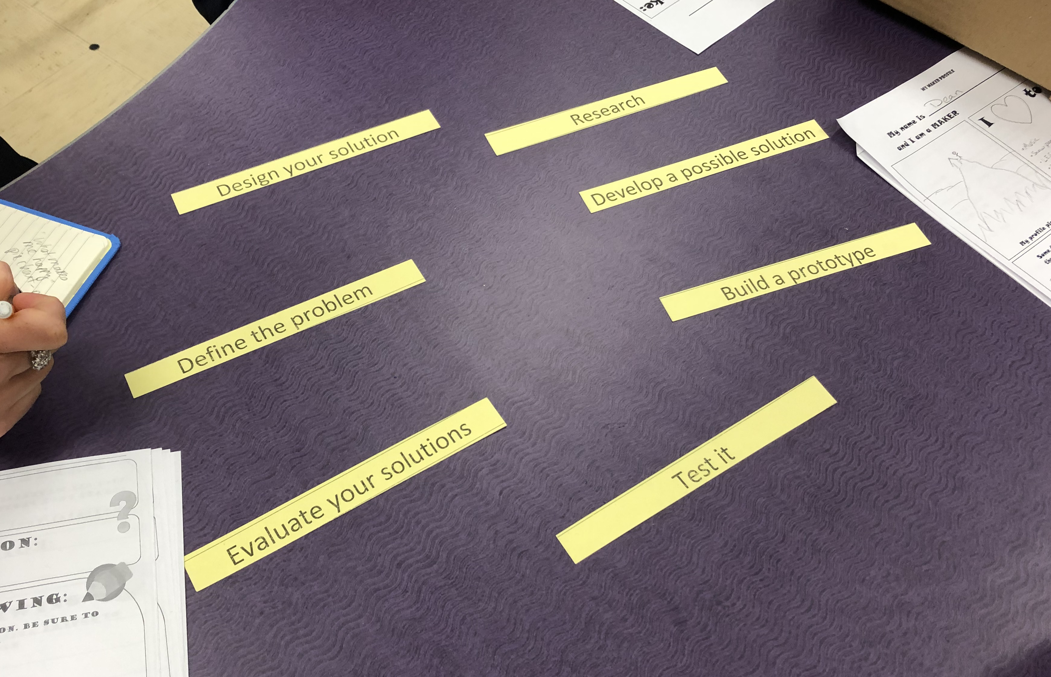
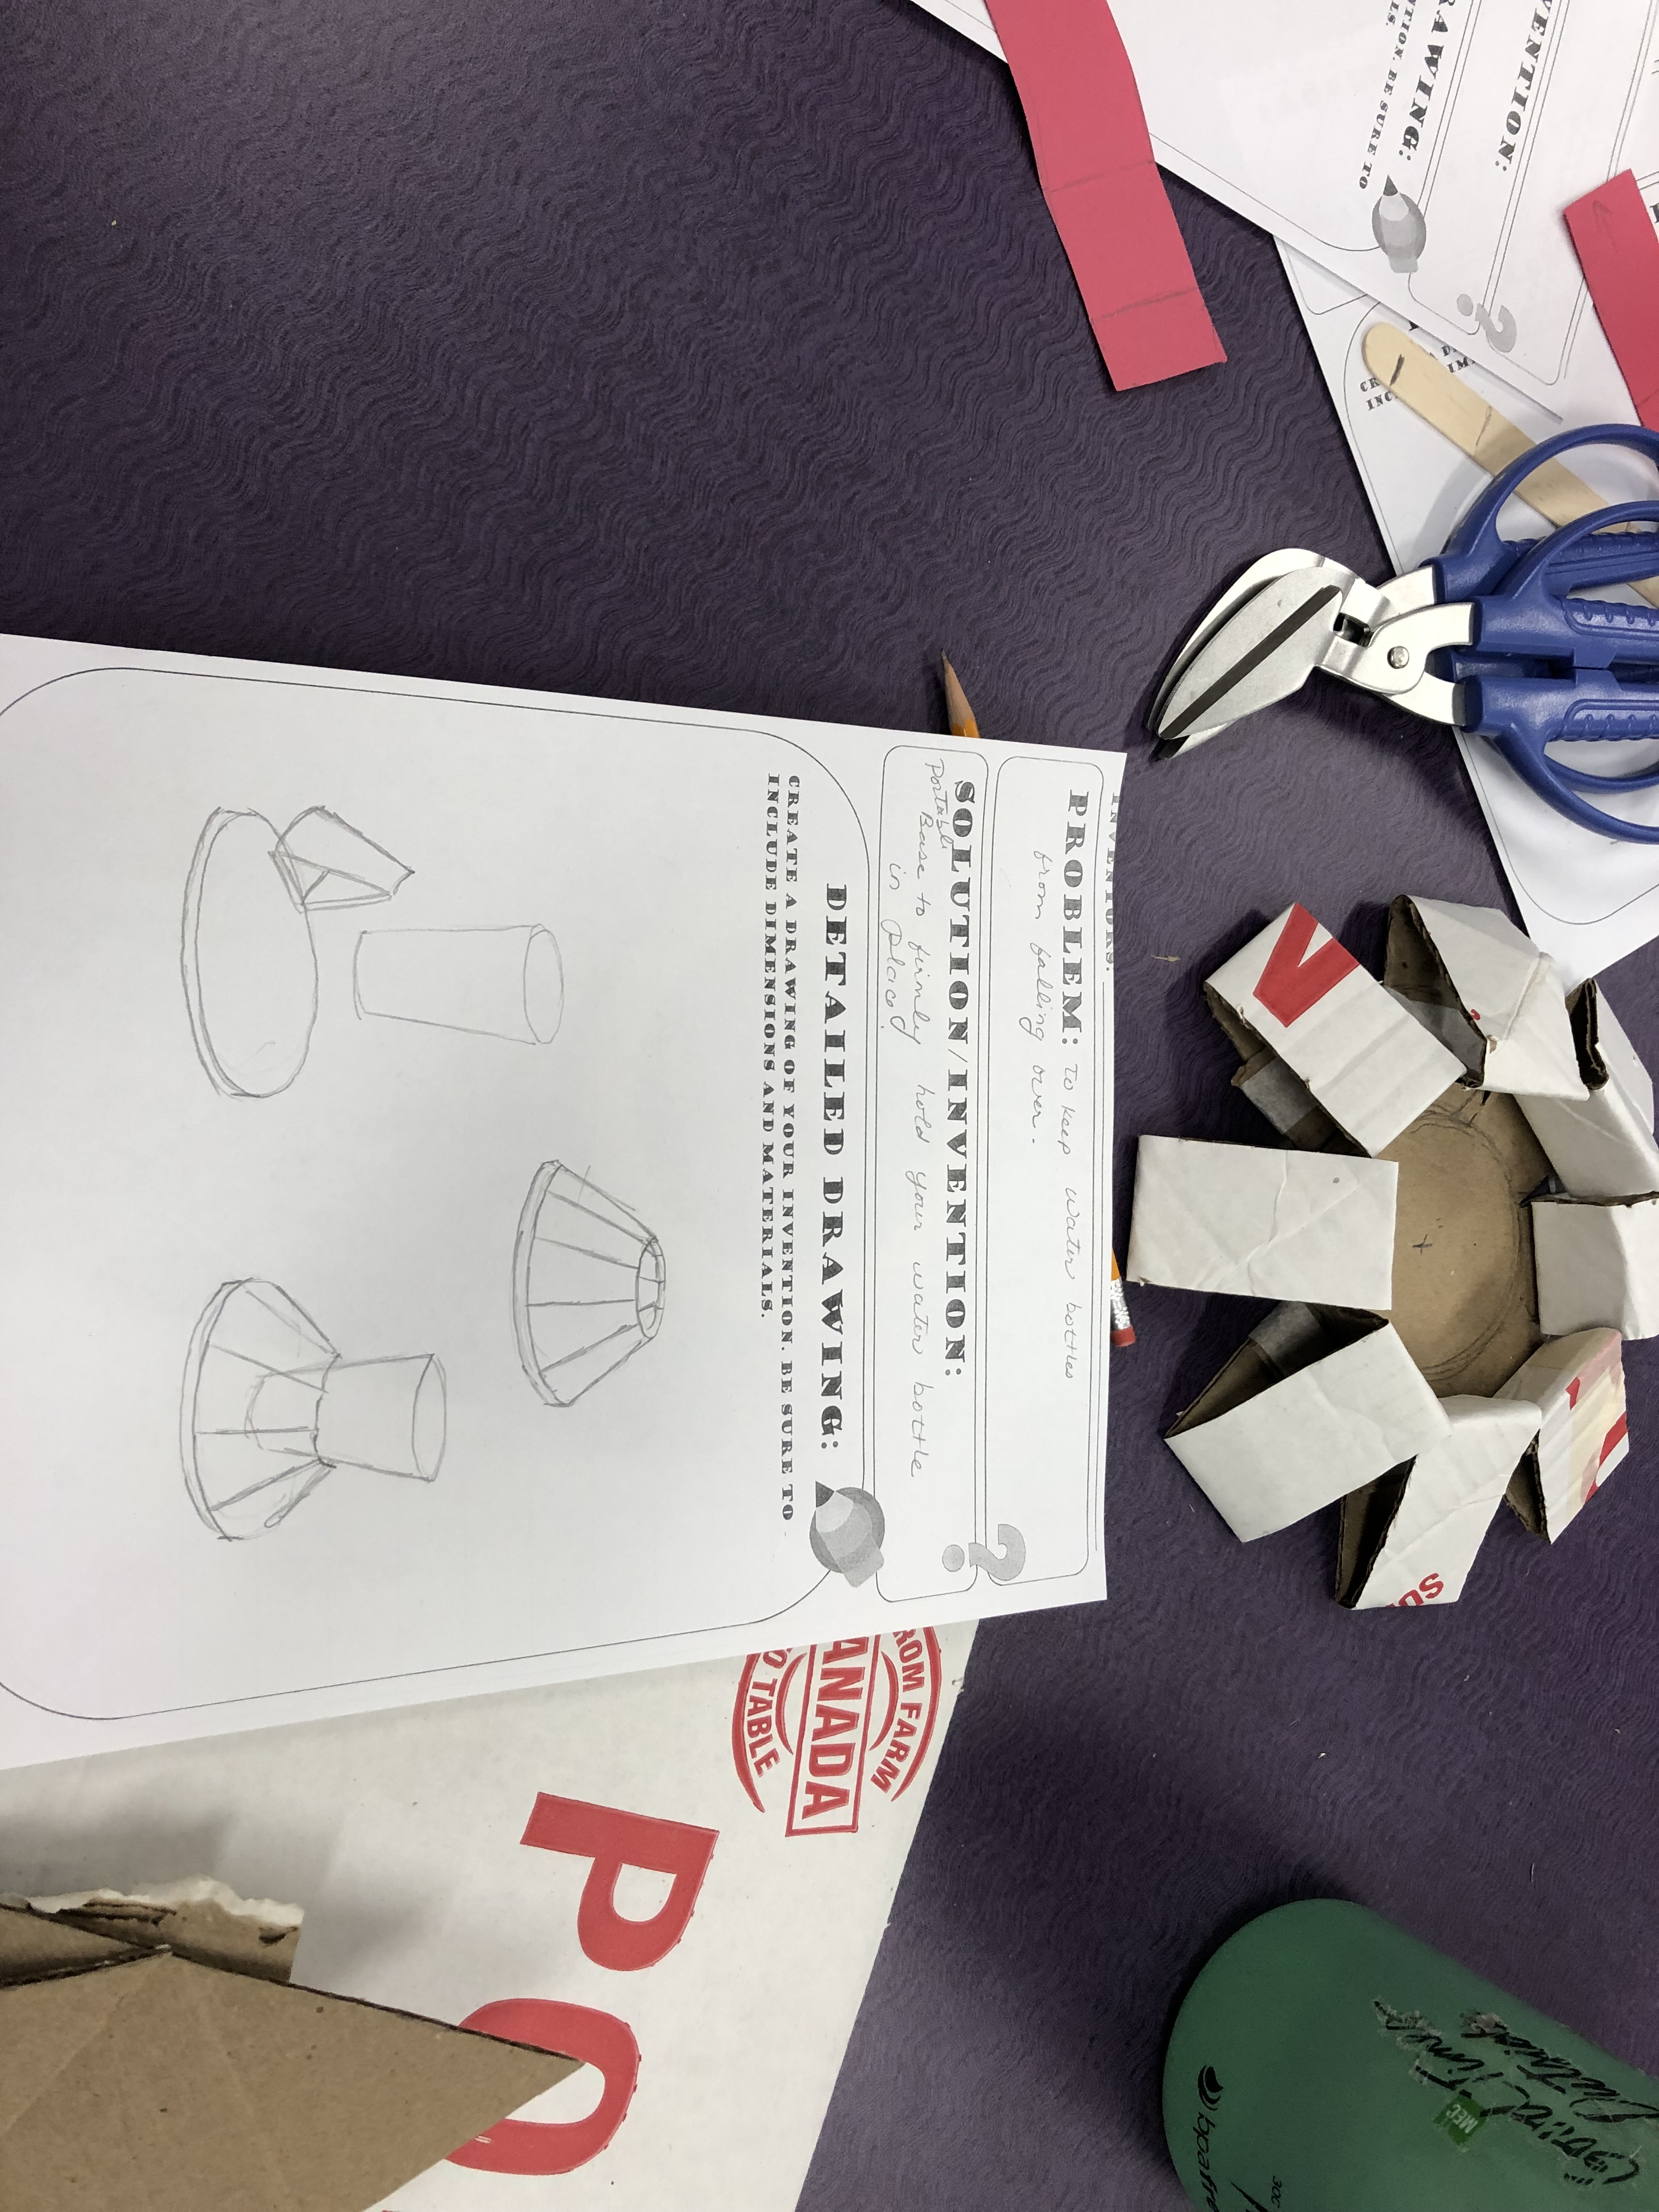
Design Thinking Process

Slide 4
WHY Have a Makerspace?
A Place to create
Learn how to Produce
Place to inspire

Slide 5
Making In ASD-N
Purpose of a Makerspace:
Fosters inquiry, collaboration, empowerment, hands-on learning, choice
Meets cross curricular outcomes
Personalizes learning
Meets Global Competency goals
Meets objectives of the10-year plan

Slide 6
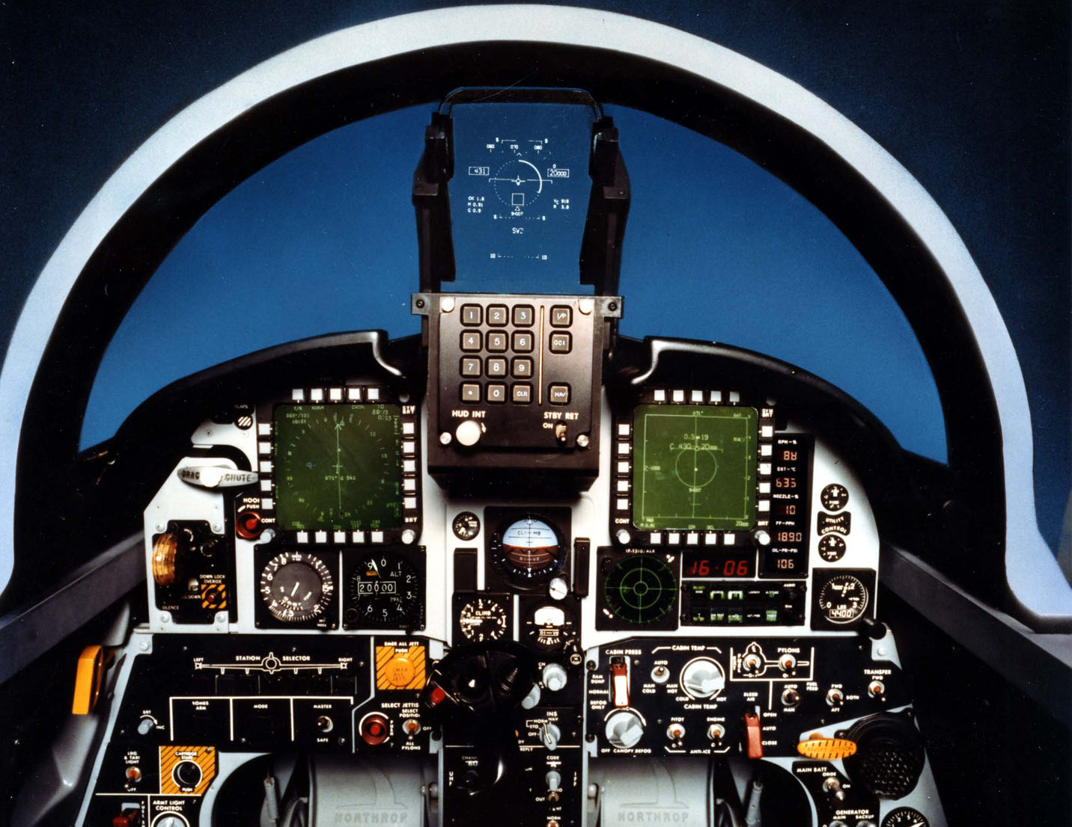
The End of Average

Slide 7
WHat is a Makerspace?
What it is:
A safe space to tinker, experiment, question, learn ...
A tool for meeting skills, inquiry and knowledge outcomes
An organized space for resources and tools

Slide 8
Tips and Tricks to organize your makerspace

Slide 9
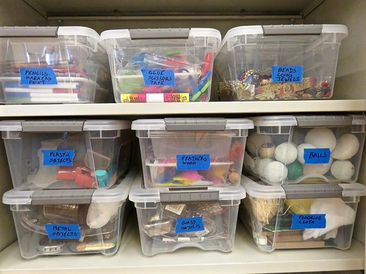
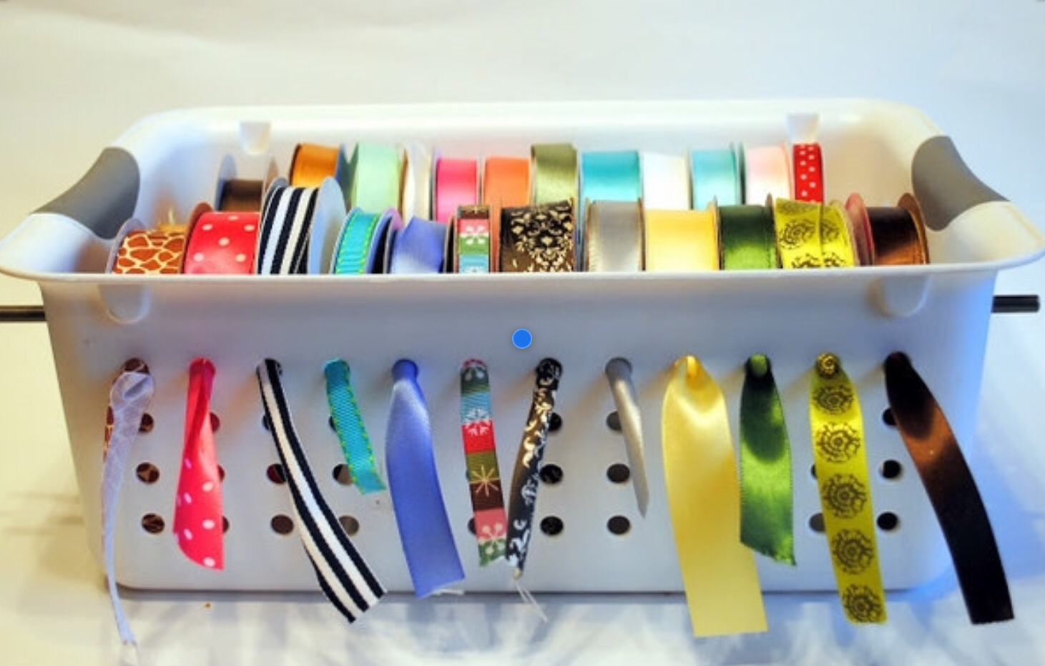

Slide 10
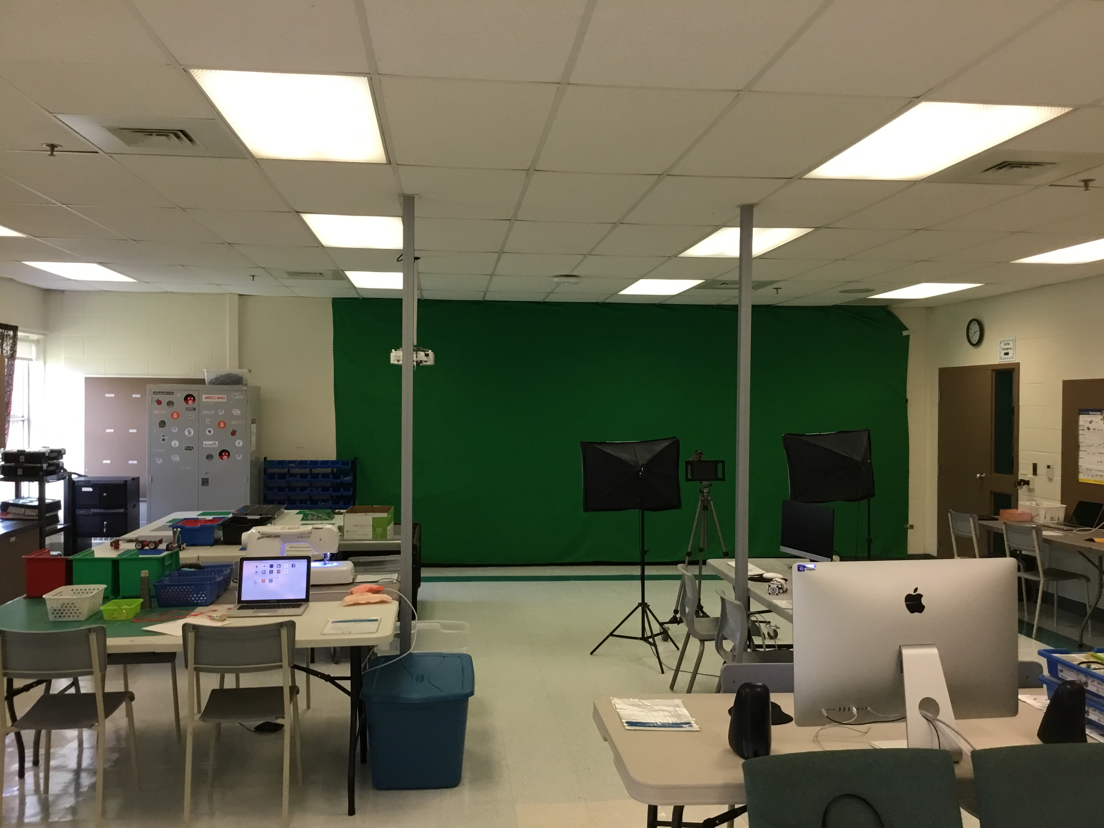
Retrackable Plug
Paint Green Screen

Slide 11
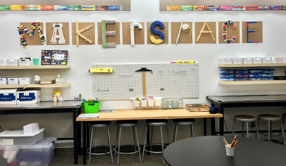
Peg Boards

Slide 12
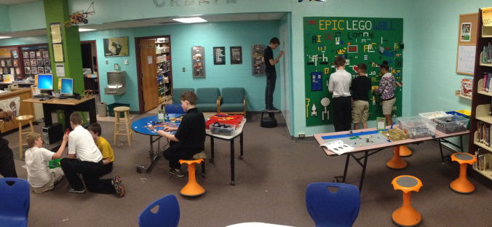

Slide 13
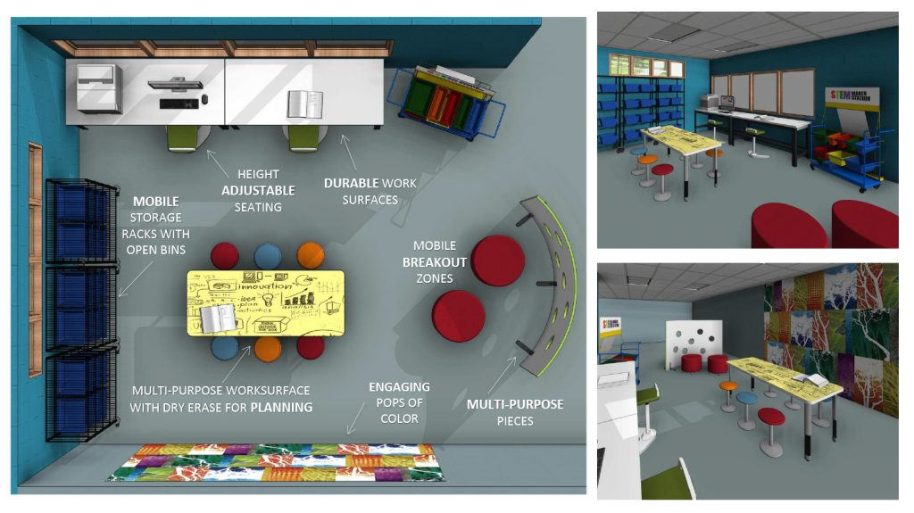

Slide 14
Other ideas
A place for items to be listed when someone takes the last one. (whiteboard)
Having a sink in the room is very useful.
Charging Station for ipads, laptops.
Setting up your space as stations ( Makey, Makey, sewing, microbits, lego, cardboard, tinkercad etc)

Slide 15
It Isn't
An open space to come and go
An unstructured format without focus
A room full of equipment that no one knows how to use
Notes:
If you are not using the equipment the school district can take it back and place it in a school that will put it to use.

Slide 16
Possible Curricular Outcomes for a Makerspace: Example: Catapult Challenge
Literacy
Numeracy
Science
Procedural
Historical Timelines
Lists
Poem –Haiku
Non-standard measurement
Estimation
3D objects
Averages
Ordering Numerals
Probability
Forces & Simple Machines (gr 5)
Skills outcomes: Initiate/Plan, Perform/Record, Analyze/Interpret
Motion (gr 10)
Projectiles, Circular Motion & Universal Gravitation(gr 12)
Speaking &Listening
Researching/Comprehension

Slide 17
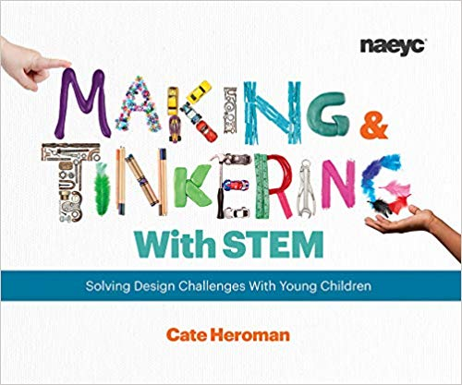
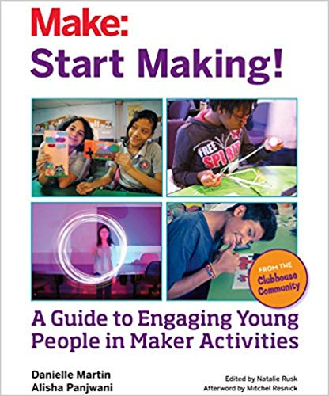
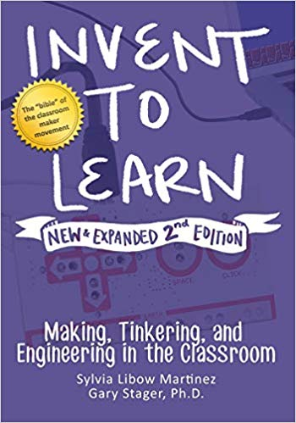
RESOURCES
FUNDING
Grants: Personalization, I-Hub, Brilliant Labs, APEGNB
TWCF, School Administration
School community (Parents)
BOOKS
Make: Start Making ! - Danielle Martin
Making and Tinkering - Kate Heroman
Brillant Labs Magazine
Invent to Learn (2nd ed.) - Stager & Martinez
PEOPLE
Lesa Scott – Brillant Labs
Joey Savoy – STEAM coordinator
Kelly Russell – STEAM Lead
Haley Doucet – STEAM Lead
Krista Hamilton – STEAM/Science Lead

Slide 18
We would like to hear from you!
Please take 2-3 min to complete the survey to let us know how we can best support your STEAM teaching this year
ASD-N STEAM PL
Feedback

